Slide 1
Pitching
A Good Practice?
Vaido Mikheim
Tartu Science Park

Slide 2

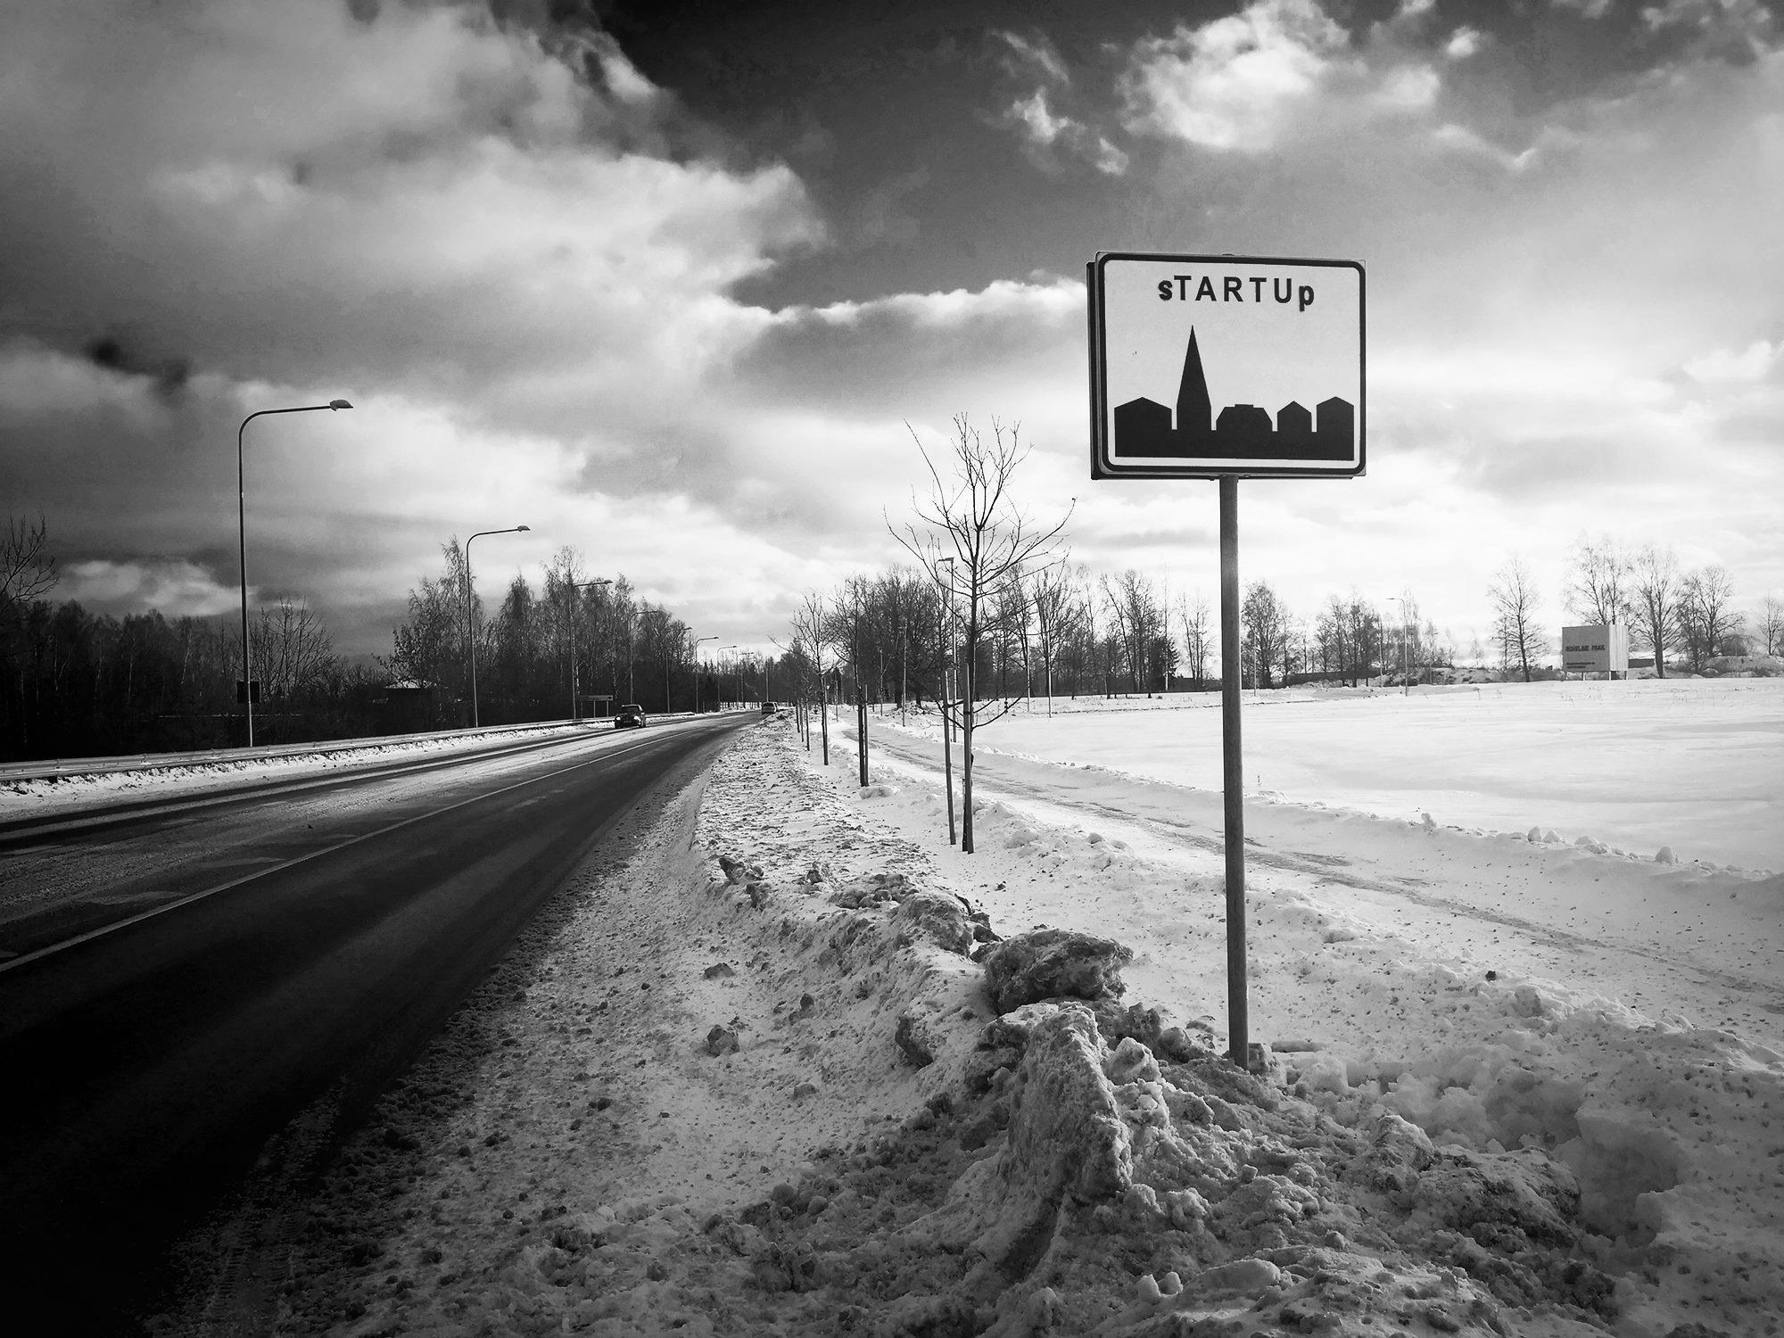
STARTUP
ECOSYSTEM
Notes:
Uuendatud

Slide 3
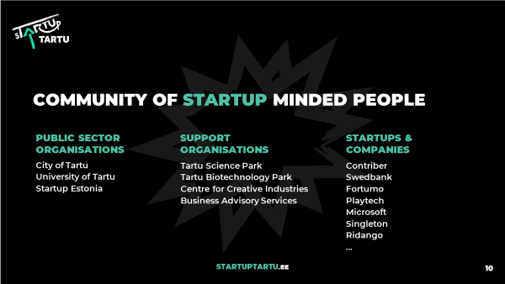
STARTUP
ECOSYSTEM
Notes:
Uuendatud

Slide 4
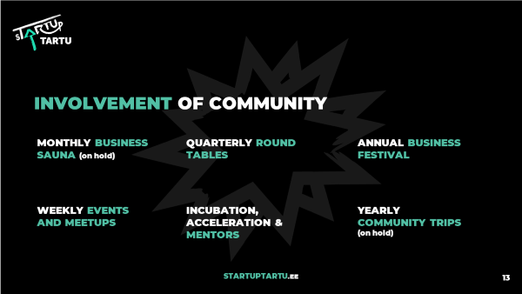
STARTUP
ECOSYSTEM
Notes:
Uuendatud

Slide 5
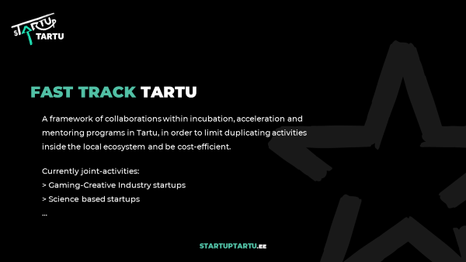
STARTUP
ECOSYSTEM
Notes:
Uuendatud

Slide 6
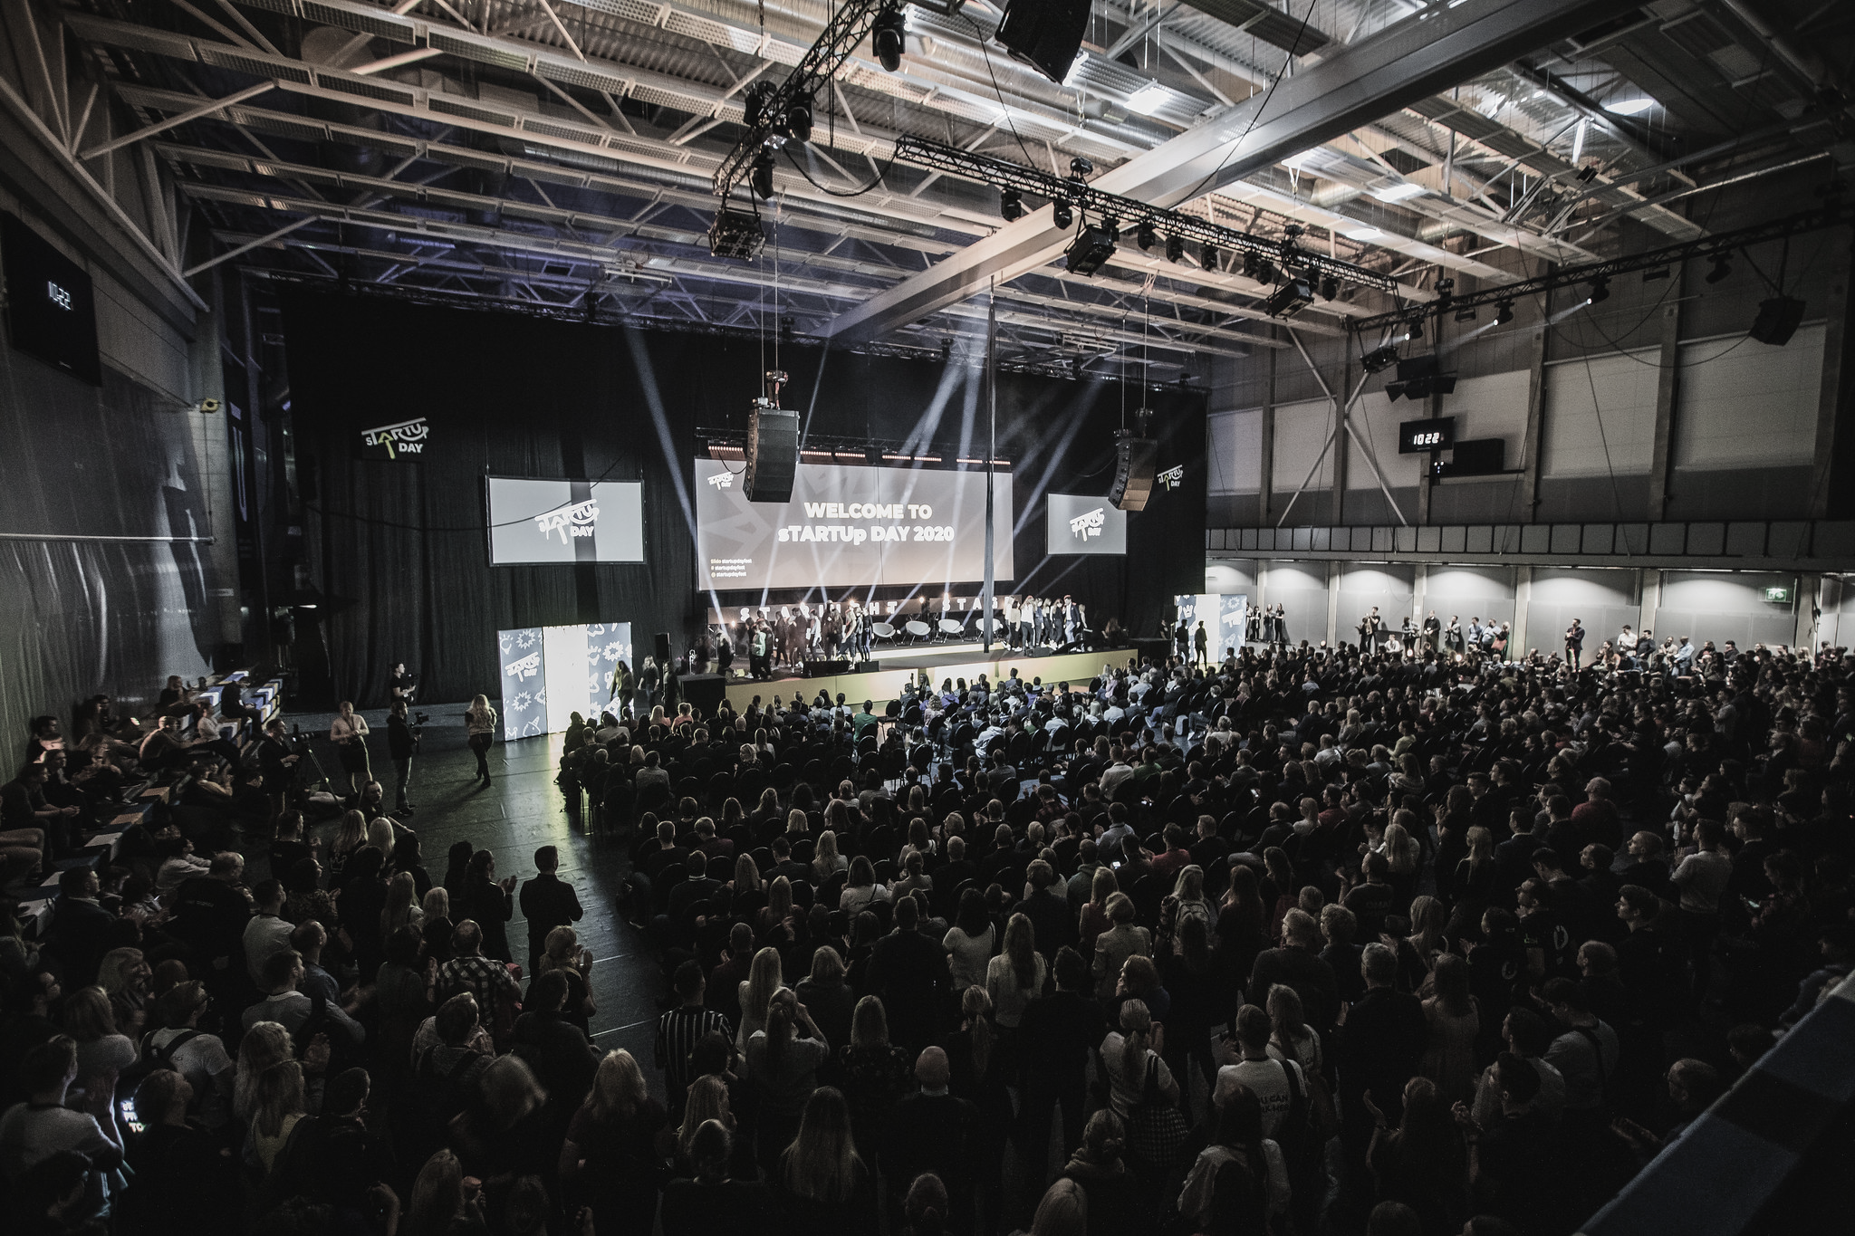

THE BIGGEST BUSINESS
FESTIVAL IN THE BALTICS
FROM ZERO TO HERO
Notes:
Tekst muudetav

Slide 7
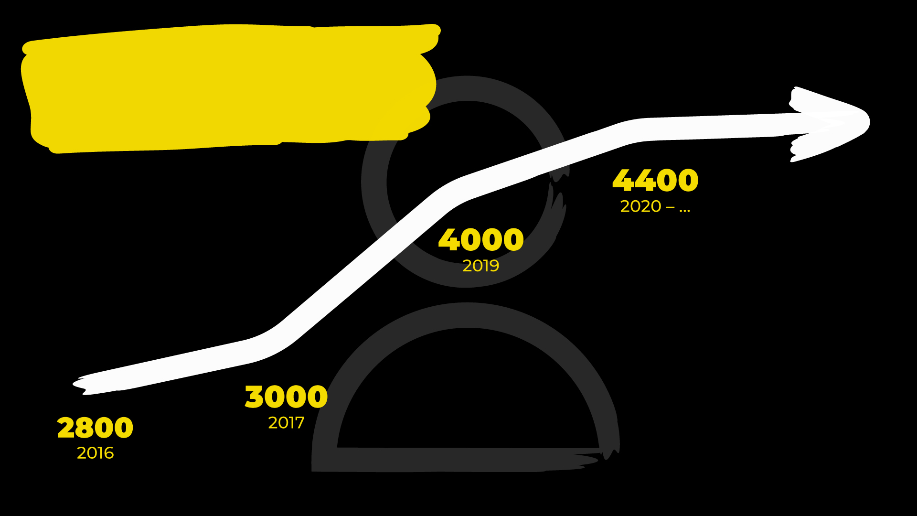

OVERALL
PARTICIPANTS
FROM ZERO TO HERO
7

Slide 8
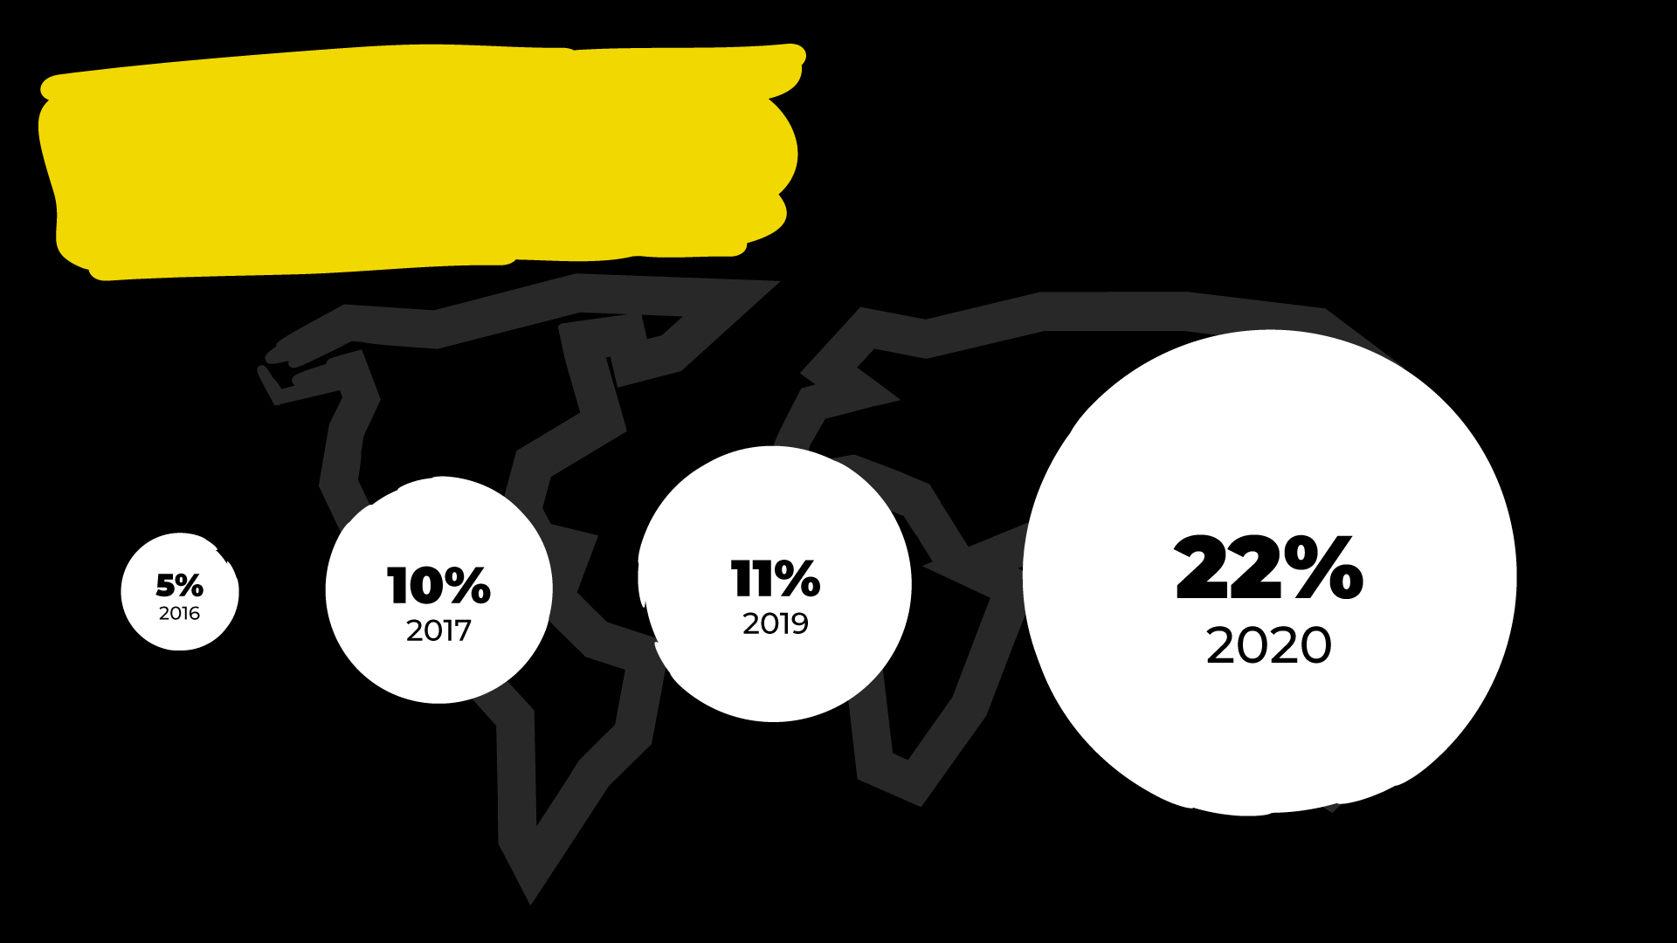
% OF INTERNATIONAL
PARTICIPANTS
FROM ZERO TO HERO
8

Slide 9
I truly hope to see You and your friends at sTARTUp Day 2021
and/or
@ sTARTUp Day 2022
www.startupday.ee

Slide 10
Questions?

Slide 11
Why do we talk (about pitching)?

Slide 12
Why do we talk?
have to
want to
need to
In general, we want to be understood

Slide 13
WHY me?
I believe you all have something to say which is worth being heard.
And understood.

Slide 14
WHY You?
Because You have to?
Because You want to?
Because You need to?

Slide 15
Pitching is one form of
communication

Slide 16
An elevator pitch is a short description of an idea explained in a way so that anyone can understand it quickly.

Slide 17
WHO are we talking to?
WHY are we talking?
WHAT should we say?

Slide 18
Audience
How many?
What kind?
What do they care about?

Slide 19
WHY
DO
YOU
CARE?

Slide 20
CALL TO ACTION
What do you want?
How can I help You?

Slide 21
1
Takeaway
What is the one thing You want me to remember?

Slide 22
What is the problem you solve?

Slide 23
What is the human result?

Slide 24
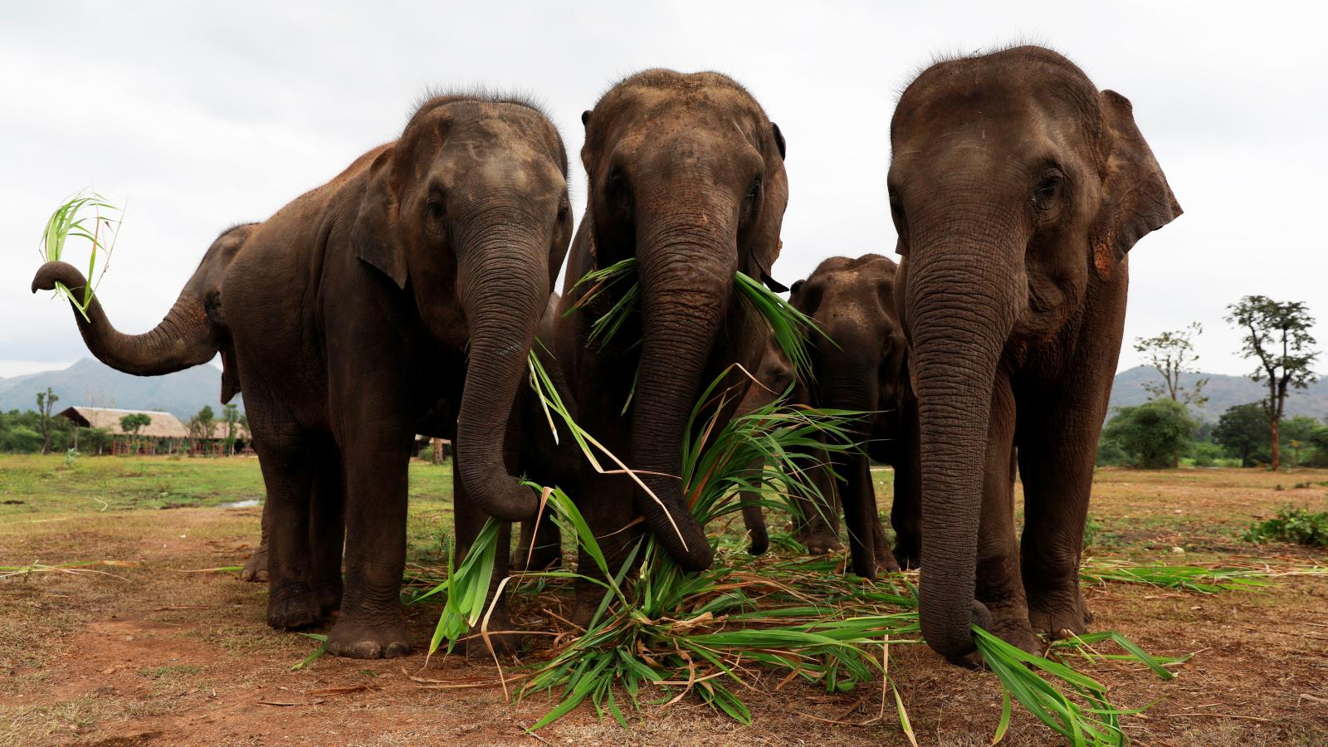
Elephants

Slide 25
CREDIBILITY
aka
Why should I trust You?

Slide 26
First 20* seconds
buys attention
* Paul Hellman “You’ve got 8 seconds”

Slide 27
SUMMARY
Human problem / solution
Call to Action
Less is more
Why You

Slide 28
Questions?

Slide 29
THANK YOU
*bonus advice: get some sleep
vaido@sciencepark.ee

