Slide 1
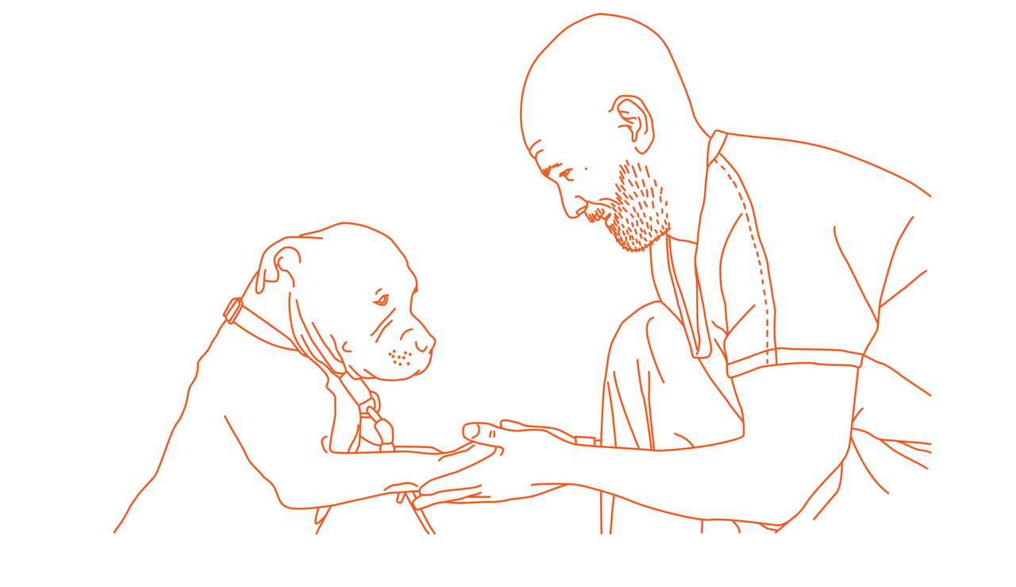

Sandra Liiv

Slide 2
Käpp ja Käsi / Paw and Hand
Is a program that brings together people who have been in prison and dogs that live in dog pounds. Under the supervision of professional dog trainer and a psychologist, they meet 16 times over 8 weeks to learn new skills in dog training.

Slide 3
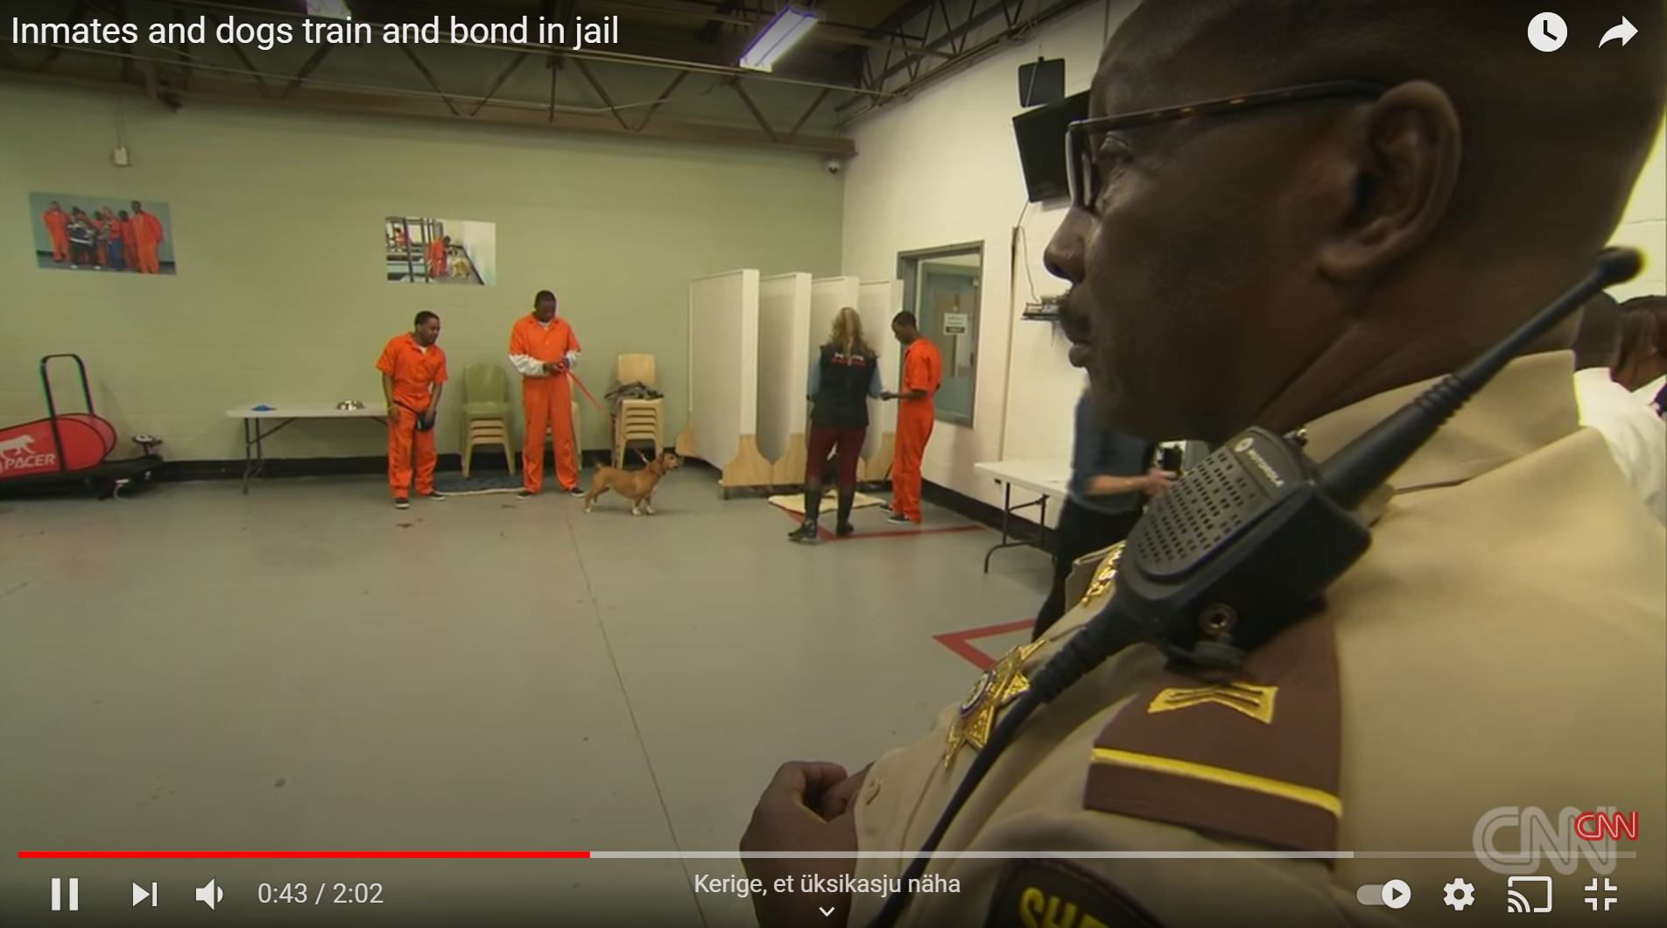
How did we start?

Slide 4

NULA
A 6-month intense development programme
Consists of:
  training days,
  meetings with mentors,
  constant work on the solutions from home.

Slide 5
  The focus topics are:
    solution design,
    testing on target groups,
    measuring impact,
    budgeting and the preparation of a financial plan,
    communication activities,
    team strengths and weaknesses,
    and preparation of an action plan for implementing the solution.

Slide 6
VALIDATING OUR IDEA
Customer assumption:
  People don’t want to adopt dogs from shelters, due to lack of social skills and training.
  Prisoners lack of meaningful activities.
Problem assumption
  Ministry of justice and prisons are motivated to co-operate with partners who offer prisoners’ meaningful activities, that also have impact on the recidivism of prisoners.
Solution assumption
  Liis is willing to pay for adopting a dog, who has been trained by a prisoner, from a shelter.

Slide 7
VALIDATING OUR IDEA
a list of friends, who we knew, that were thinking of taking a dog;
contacted a friend of a friend, who we knew, had been in prison;
contacted animal shelters and dog trainers and asked their opinion;
round table for opinion leaders of both fields;
GOOGLE;
connect with USA programs;
network of local specialists of both fields.

Slide 8
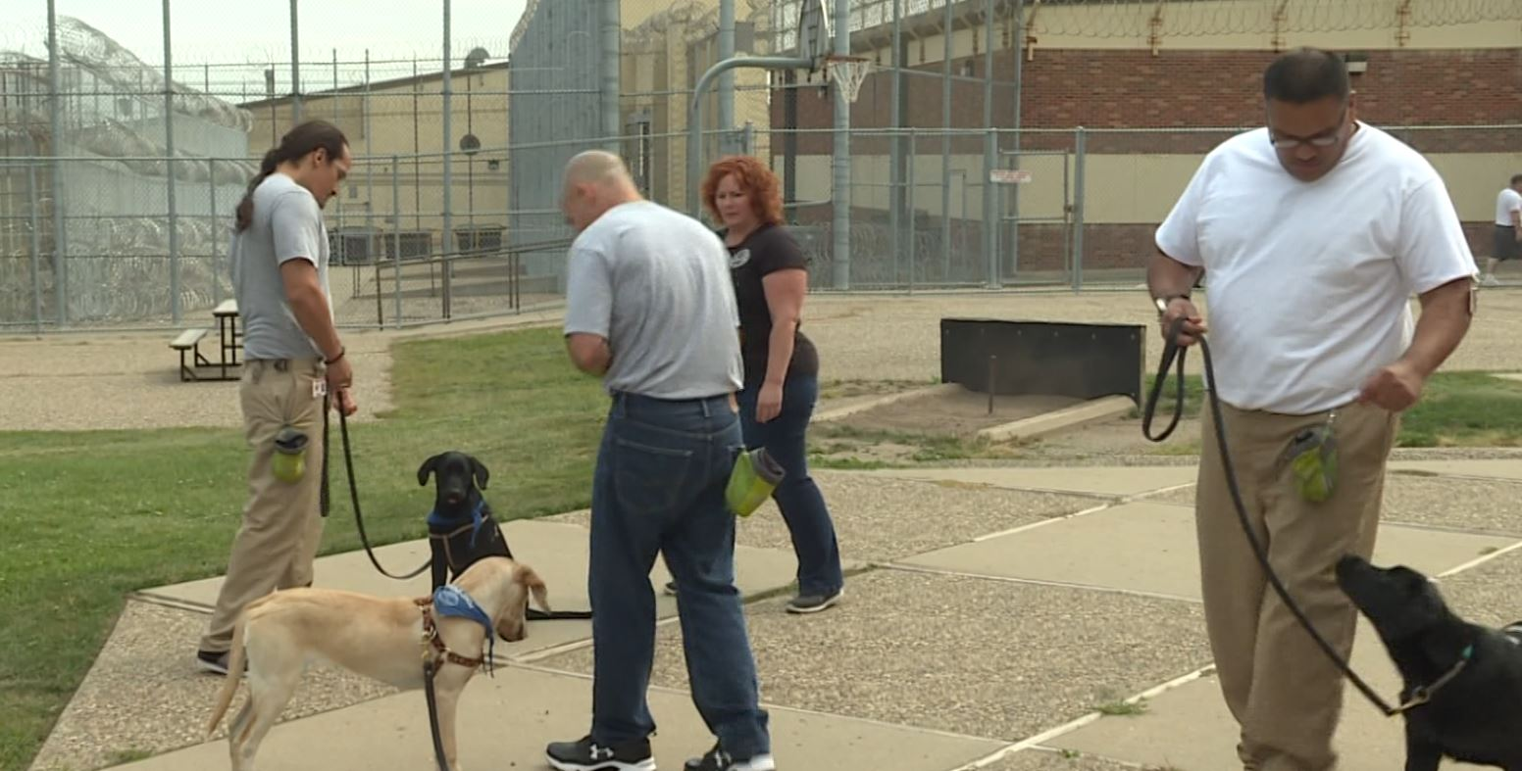
What we wanted to do?

Slide 9
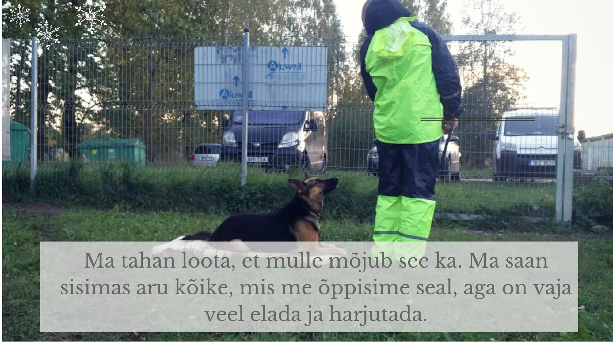


What we ended up doing?
I want to hope that it has some kind of impact on me. I understand everything we learned there, but I need time to practice.

Slide 10





Paw and hand today

Slide 11
