Slide 1
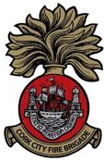

Stove Fire Safety
A Fire Safety Message
From
Cork City Fire Department

Slide 2
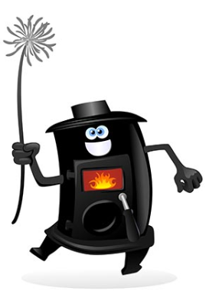
Stove Fire Safety
Tips before you buy
Buy your stove from a specialist
When adding a new stove to your home, always have the work carried out by an accredited/competent installer.
Gas stove fitters should be registered with RGII, and while there is no regulatory body for solid-fuel fitters, most reputable installers will be HETAS trained.
All works carried out should be compliant with the Building Regulations 1997- 2019 (Technical Guidance Document Part J - Heat Producing Appliances).

Slide 3
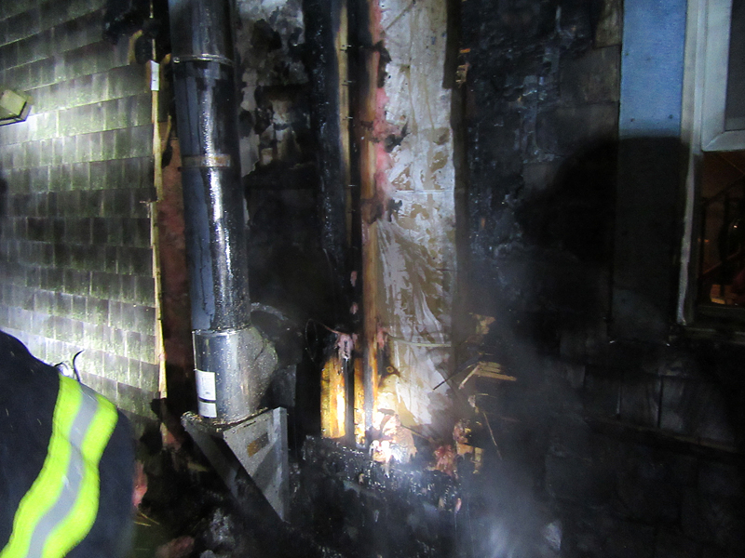
Stove Fire Safety
Aftermath of a Stove Fire
Don’t let your home fire be the cause of your house fire

Slide 4
Stove Fire Safety
Installation Tips
Make sure the installer uses a flexible flue liner from top to bottom of the chimney – best practice is to back fill with vermiculite – the liner acts as a chimney within a chimney.
Provide a hearth at the base of the stove.
Provide sufficient space from combustible materials around the stove. Timber surrounds, TVs or materials such as curtains and carpets may all present a fire hazard.
Ensure sufficient ventilation is provided in the room containing the stove (in accordance with the Building Regulations).
A smoke & carbon monoxide detector
should be installed in every room
containing a stove.

Slide 5
Stove Fire Safety
Usage Tips
Do not use flammable liquids to start a fire
Never burn household waste
Only use the recommended fuel for your stove
Use a spark guide to prevent sparks from open fires falling onto the floor.
Don’t overload a fire and don’t leave it burning
in full flame when going to bed.
Have your flue/chimney cleaned regularly

