Slide 1
How to be
short, precise and nice
Vaido Mikheim
Tartu Science Park

Slide 2
WHY me?
I believe you all have something to say which is worth being heard.
And understood.

Slide 3
Present your
thesis in
15 minutes

Slide 4
Introduce
article/paper/topic
in
5 minutes

Slide 5
Make yourself
convincing in
30 seconds

Slide 6
Describe yourself
in
three words

Slide 7
WHY me?
Tartu Science Park startup advisor since 2010
Event moderator & speaker since 2012
Mentor for startups & student teams since 2015
Guest lecturer here and there since 2016
sTARTUp Day Pitching Stage manager 2018-2021

Slide 8
WHY You?
Because You have to?
Because You want to?
Because You need to?

Slide 9
An elevator pitch, elevator speech, or elevator statement is a short description of an idea, product or company that explains the concept in a way such that any listener can understand it in a short period of time.
https://en.wikipedia.org/wiki/Elevator_pitch

Slide 10
An elevator pitch is a short description of an idea explained in a way so that anyone can understand it quickly.

Slide 11
Why do we talk?
have to
want to
need to
In general, we want to be understood

Slide 12
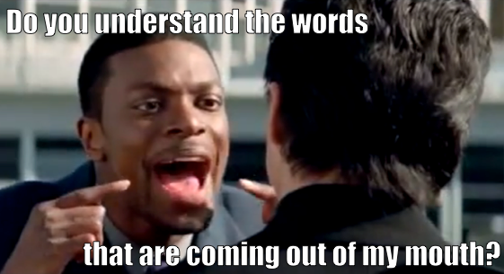

Slide 13
Questions?

Slide 14


Slide 15
WHO are we talking to?
WHY are we talking?
WHAT should we say?

Slide 16
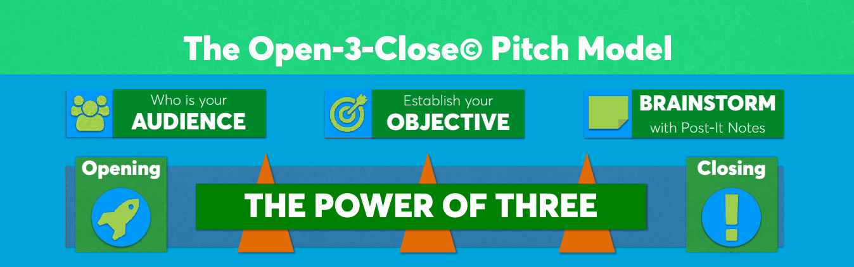
The Open-3-Close Model
Best3minutes.com / David Beckett

Slide 17
Audience
How many?
What kind?
What do they care about?

Slide 18
Audience
How many – can you talk with them all?
What kind – pragmatic, conservative, doers, innovative?
What do they care about – money focused, environmental, social?
What might be their biggest objection?

Slide 19
Objective
WHY
DO
YOU
CARE?

Slide 20
Objective
What do you want them to do?
Action.

Slide 21
CALL TO ACTION
What do you want?
How can I help You?

Slide 22
1
Takeaway
What is the one thing You want me to remember?

Slide 23
Questions?

Slide 24

OBSTACLES

Slide 25
What you can’t control:
Time
Audience
Environment

Slide 26

Time
At what time you will talk
How much time you have
Attention span
Q&A time

Slide 27
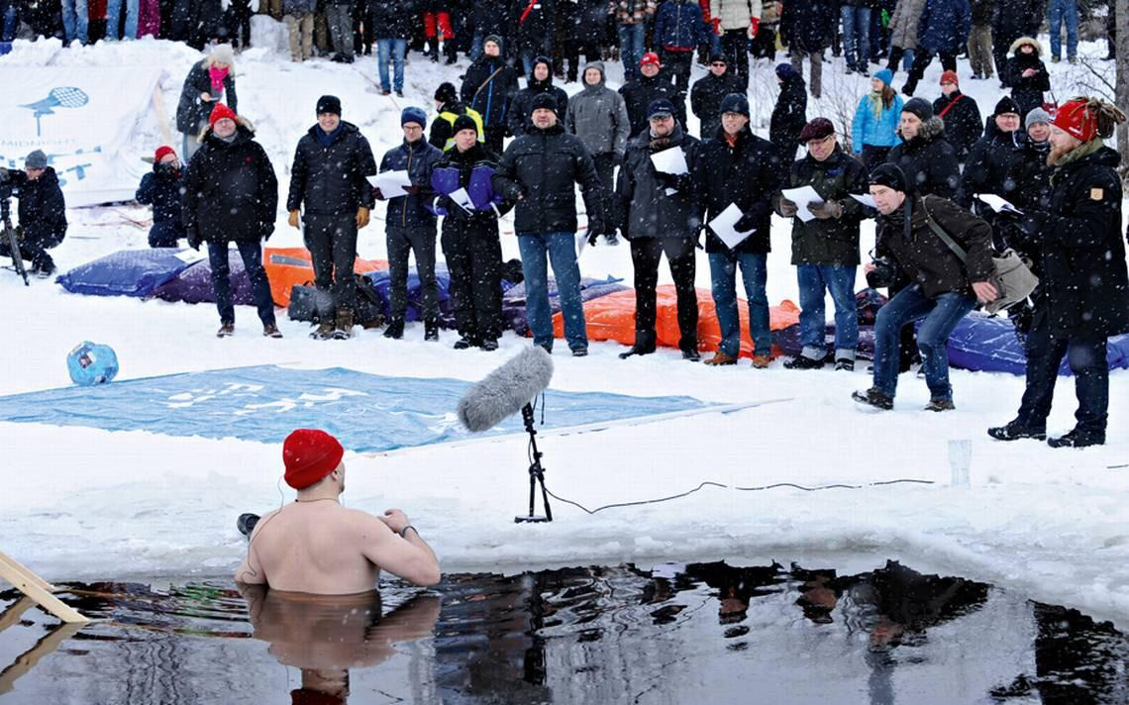
Environment
What and where is the venue
What’s the setup of the venue
Equipment
Variables*

Slide 28
What you can control:
Yourself
Time
Slides
Q&A

Slide 29
STORYTELLING

Slide 30
What You do
first when creating
a presentation?

Slide 31
What is the
First Thing
You do
When creating
a Story?

Slide 32

SOLUTION

Slide 33
What is the problem you solve?

Slide 34
What is the human result?

Slide 35
Lost time?
More cost?
Irritation?
Bad reputation?

Slide 36
CREATE
RELATABLE
CONNECTIONS

Slide 37
Questions?

Slide 38
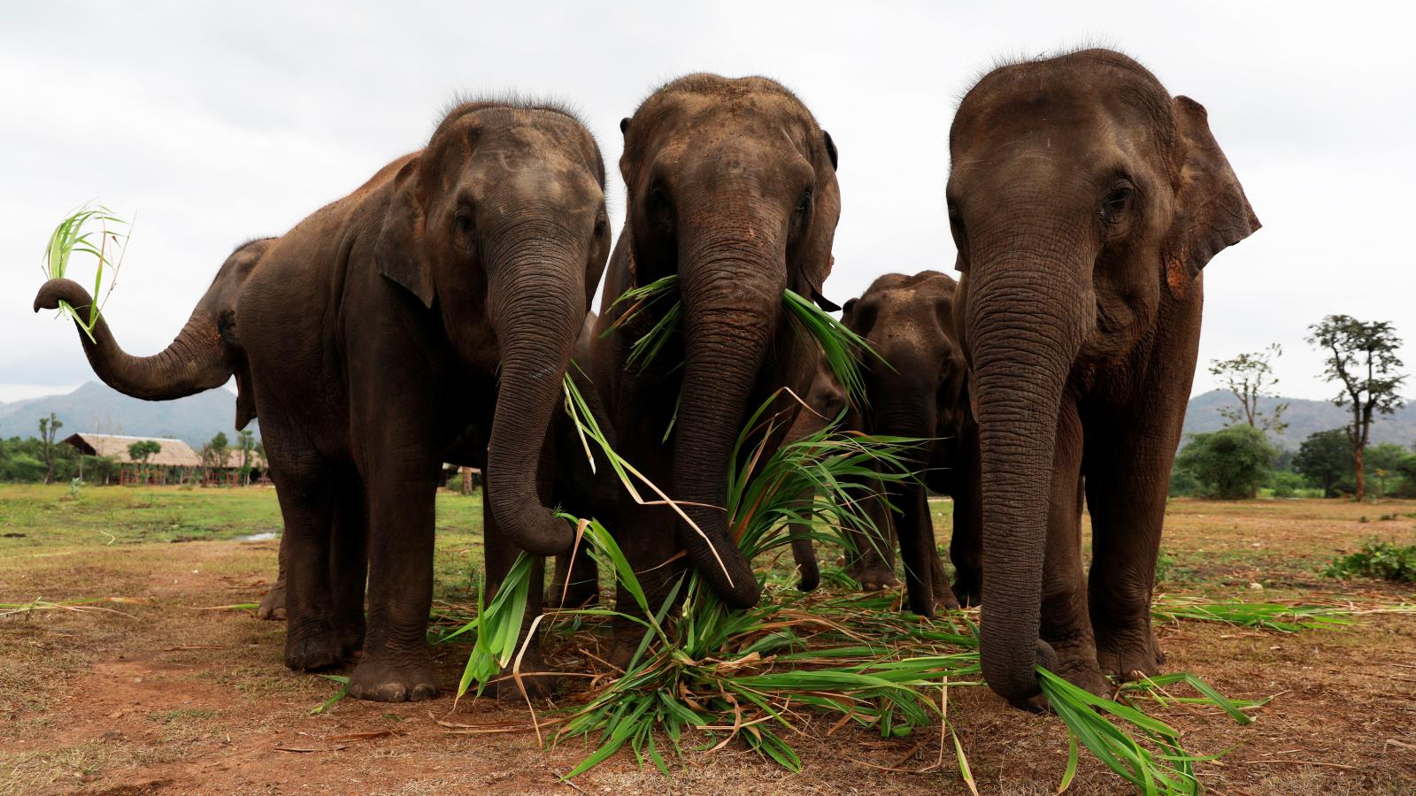
Elephants

Slide 39
CREDIBILITY
aka
Why should I trust You?

Slide 40
First 20* seconds
buys attention
* Paul Hellman “You’ve got 8 seconds”

Slide 41
Is this person professional?
Do I need/want to know more?

Slide 42
Quantify
and/or
Validate
The Problem

Slide 43
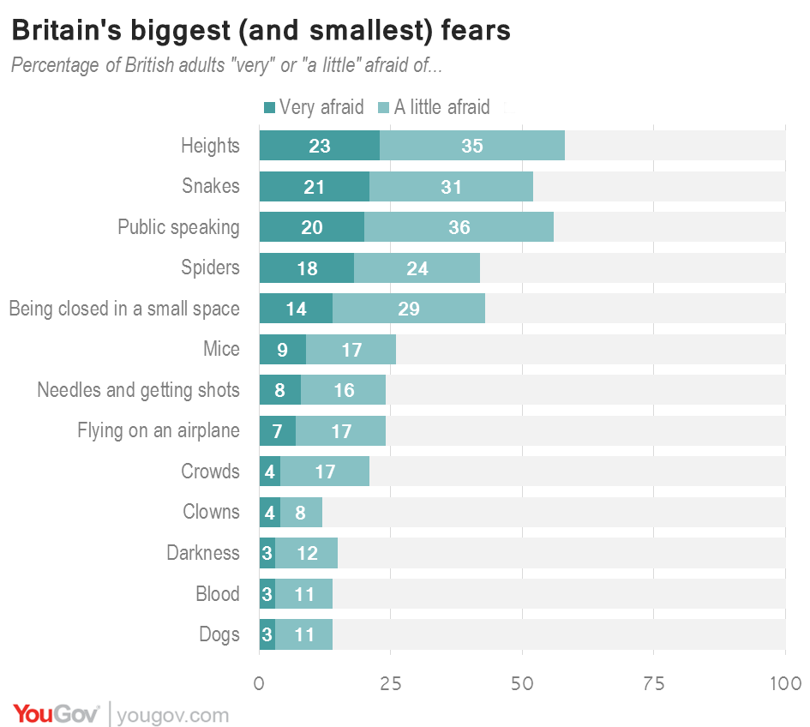
VALIDATE

Slide 44
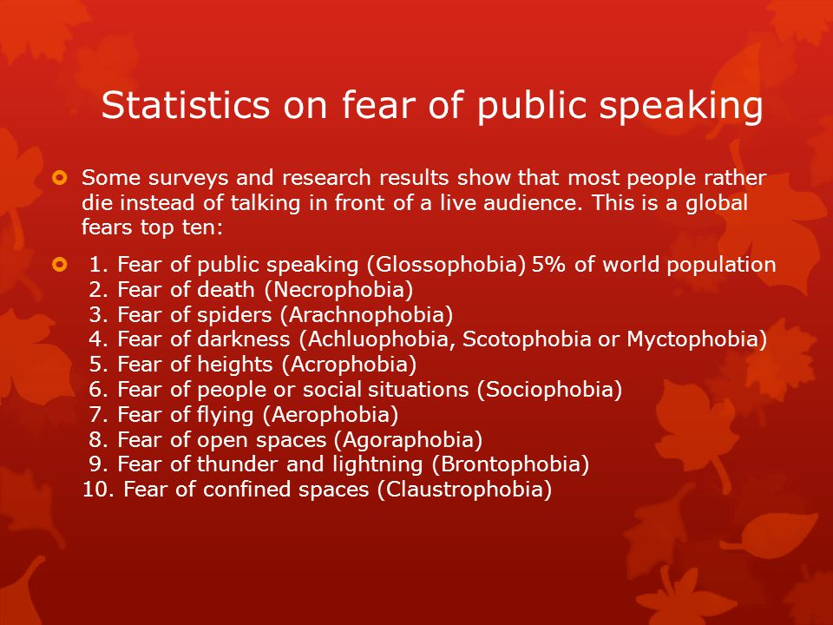

Slide 45
CREDIBILITY
aka
Make Me believe You can do it

Slide 46
Show* the roadmap
aka
How are You going to get There
* You can visualize it in my mind

Slide 47
CALL TO ACTION
What do you want?
What do you need?
How can I help You?

Slide 48
CALL TO ACTION
Money?
Advice?
Introductions?
Follow-up meeting?

Slide 49
LESS
IS
MORE

Slide 50
LESS IS MORE
How many words per minute?
130-140 words
=
9 sentences

Slide 51
Don’t overspend
on
technicalities

Slide 52
Don’t. Overspend.
On.
Technicalities.

Slide 53
1
Takeaway
What is the one thing You want me to remember?

Slide 54
SUMMARY
Human problem / solution
Call to Action
Less is more
Why You

Slide 55
Questions?

Slide 56


Slide 57
PRACTICE
PRACTICE
PRACTICE
PRACTICE
PRACTICE

Slide 58
SLOOOW
DOWN
really, slow down

Slide 59
BE ON TIME

Slide 60
LISTEN
the
FEEDBACK

Slide 61
FEEDBACK
Which ONE thing stood out?
Which ONE thing did you NOT understand?
One FRIENDLY piece of advice for improvement

Slide 62
DO YOUR HOMEWORK

Slide 63
Summarize
What you’ve seen is…
One sentence summary.
What we ask you to do is…
Remind the call to action
I believe this matters because…

Slide 64
Summarize
Thank You
=
I’m done, you can clap now

Slide 65
SLIDES

Slide 66
BAD SLIDE
This is a BAD slide. This is a BAD slide. This is a
BAD slide. This is a BAD slide. This is a BAD
slide. This is a BAD slide. This is a BAD slide. This
is a BAD slide. This is a BAD slide. This is a BAD
slide. This is a BAD slide. This is a BAD slide. This
is a BAD slide. This is a BAD slide. This is a BAD
slide. This is a BAD slide. This is a BAD slide. This
is a BAD slide. This is a BAD slide. This is a BAD
slide. This is a BAD slide. This is a BAD slide. This
is a BAD slide. This is a BAD slide. This is a BAD
slide. This is a BAD slide. This is a BAD slide.

Slide 67
BAD SLIDE
● This is a BAD slide.
● This is a BAD slide.
● This is a BAD slide.
● This is a BAD slide.
● This is a BAD slide.
● This is a BAD slide.
● This is a BAD slide.
● This is a BAD slide.
● This is a BAD slide.

Slide 68
BODY / FACE LANGUAGE

Slide 69

Notes:
69

Slide 70

DONT LOOK AT THE FLOOR
Notes:
70

Slide 71
Online age
Video on
=
Smiles & laughter
Gestures & nods
Facial expression

Slide 72
Online age
Camera position
=
Avoid looking down
Try to look at the camera

Slide 73
Online age
Background
=
What kind of message you want to deliver

Slide 74
Online age
Avoid backlight
Use clicker
Your voice is powerful tool

Slide 75
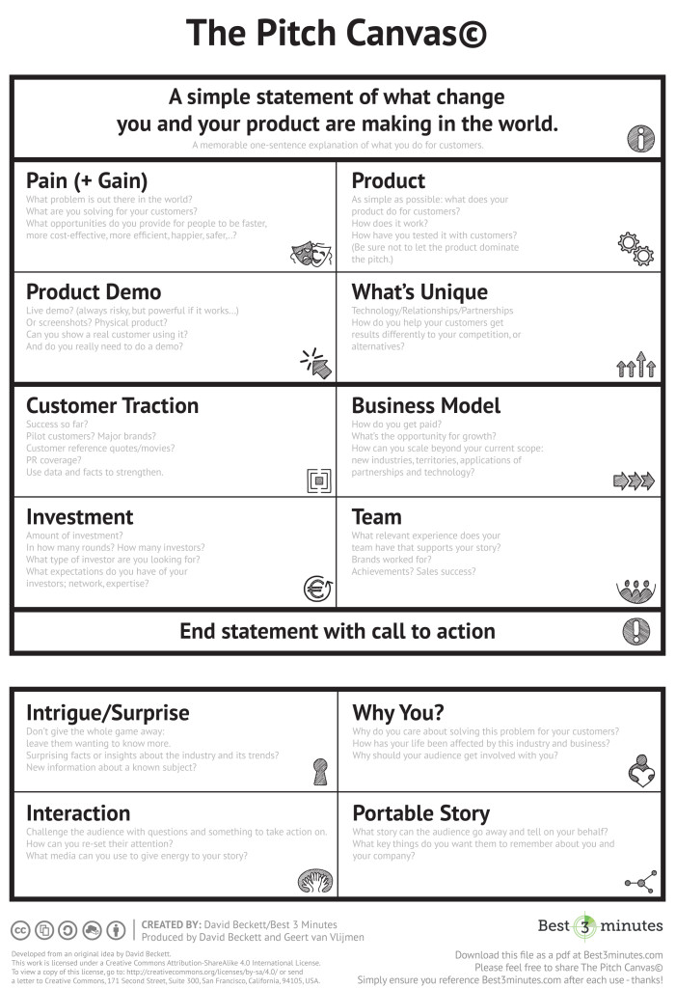
PITCH CANVAS
SLIDESHARE
TED TALKS
GOOGLE
Notes:
75

Slide 76
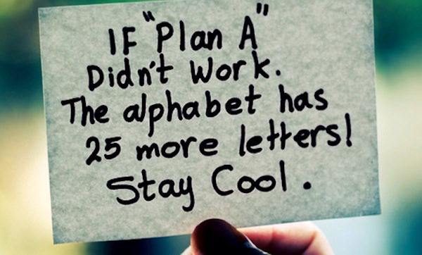
Notes:
76

Slide 77
Questions?

Slide 78
THANK YOU
*bonus advice: get some sleep
vaido@sciencepark.ee

