Slide 1

Cork City Council Guidelines for Downloading MS Teams
Recruitment Section, People & Organisation Development

Slide 2
Please read the guidelines before completing MS Teams Download
Step 1.
Email Instruction
You will receive an email from the Recruitment Team asking you to download MS Teams app on to your preferred electronic device. You do not need to set up a Microsoft Account to download the M.S. Teams and to participate in the interview. MS Teams will be automatically linked to your email address.
Step 2.
Downloading MS Teams
You can use MS Teams in 3 ways, web-based app, install MS Teams on your device, or you can install the MS Teams app on your mobile or smart device. Whatever device you chose please make sure it has video and microphone capabilities and that the visual is appropriate for your virtual interview.
Open your web browser and type into the search https://www.microsoft.com/en-ie/microsoft-teams/download-app
Follow the download instructions to complete installation.

Slide 3
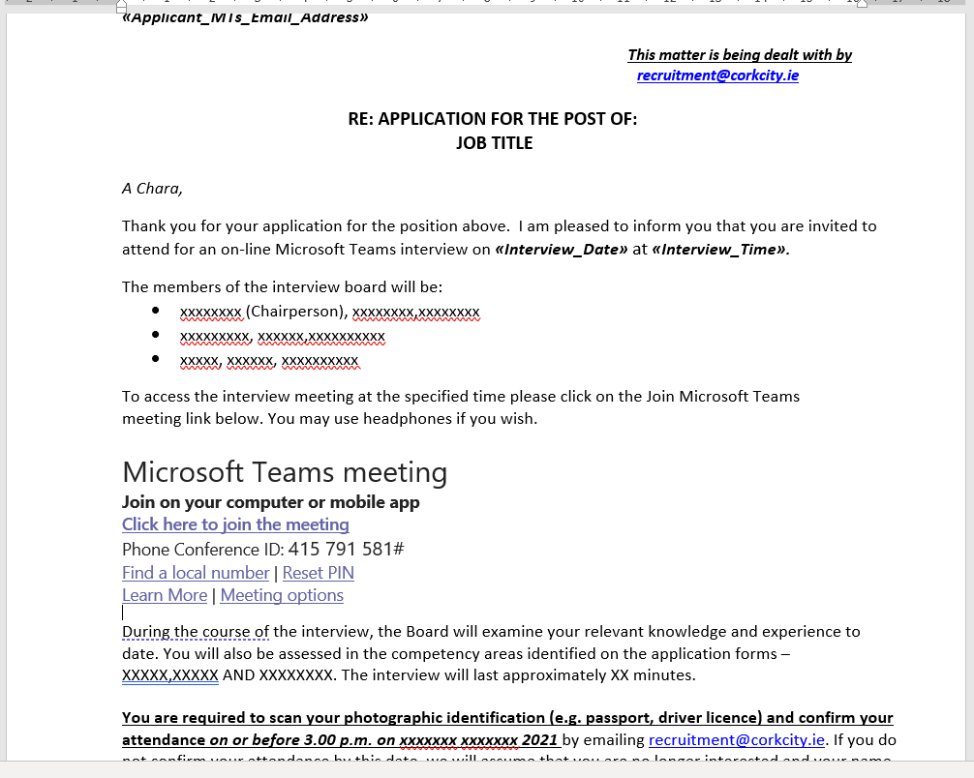
What will the email from the Recruitment Team contain?
Instruction to download MS Teams
Date and Time of your interview
Link to access your MS Teams online interview
Members of the interview board
The areas that will be examined at interview
Interview Guidance Document - Information tool on how to prepare for your upcoming virtual interview
Please do not delete this email as it contains all the information required for your virtual interview

Slide 4
Step 3.
Logging on to your MS Teams interview
Please log on in advance of your interview and ensure you and your device, are ready on time.
Click on the link provided to activate your virtual interview. This will open the MS Teams app. You must then click Join Now to enter your virtual interview.
On entering your virtual interview, you will see a notification on your screen “Waiting for Others to Join”. Please be patient until the interview board have joined the meeting.
Please Note: While we endeavour to have interviews run to schedule, from time to time we may experience slight delays. Should a delay persist a member of the Recruitment Team will contact you.

Slide 5

Checklist
Make sure you are not on mute
Audio
Working
Camera On
Positioned correctly in front of the camera
Interview complete hang up using function

Slide 6
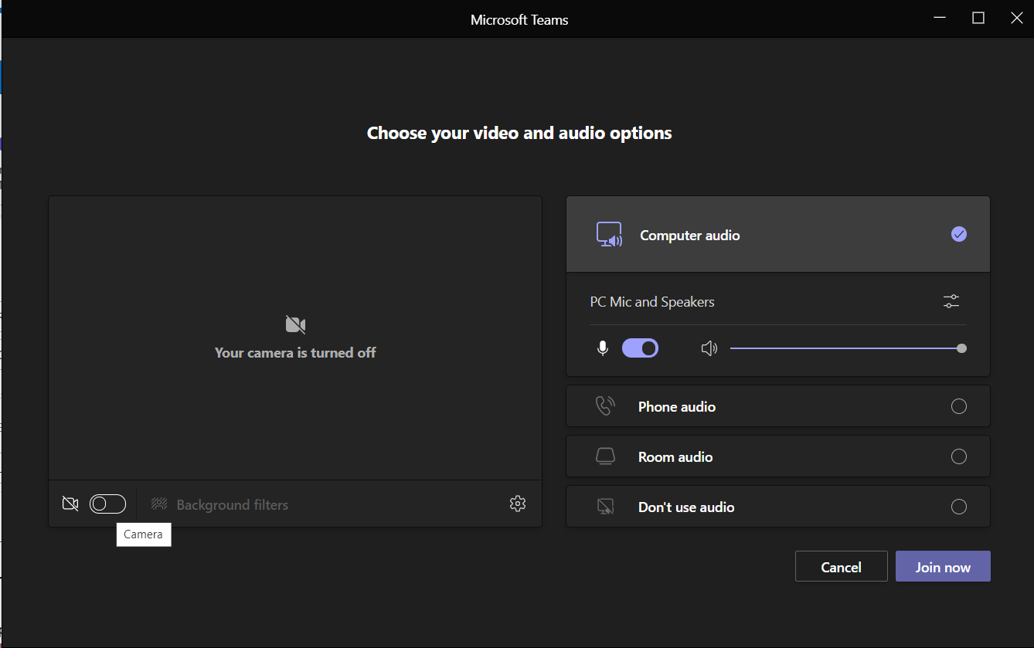
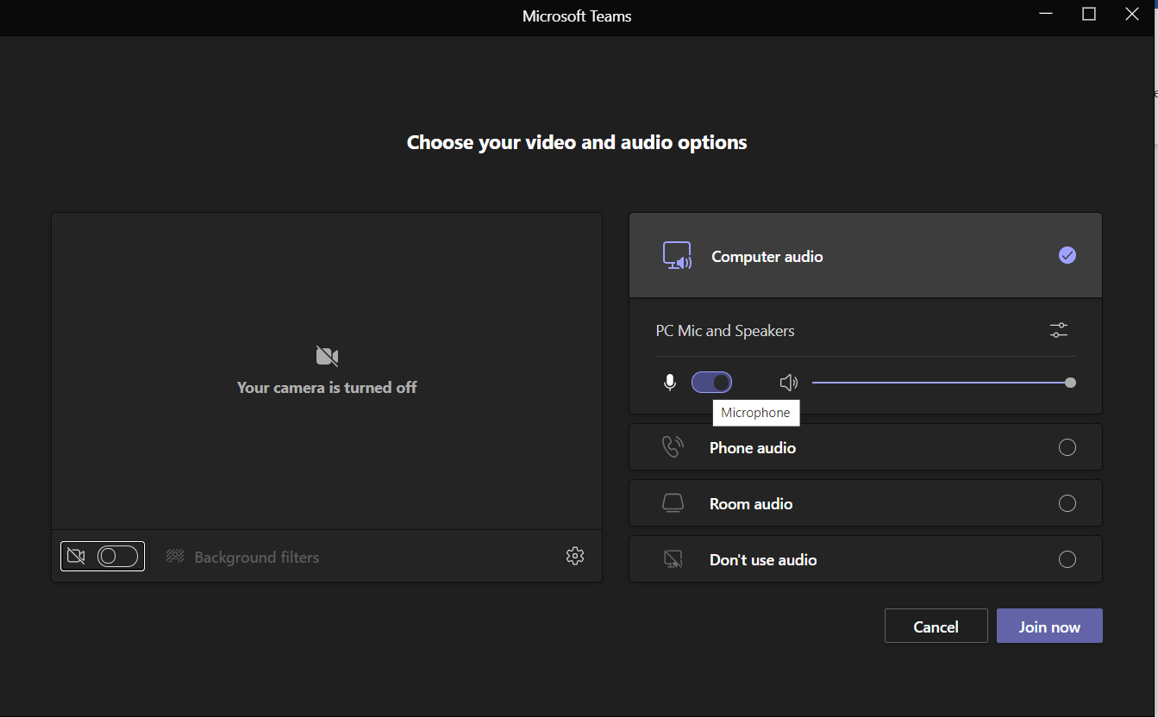
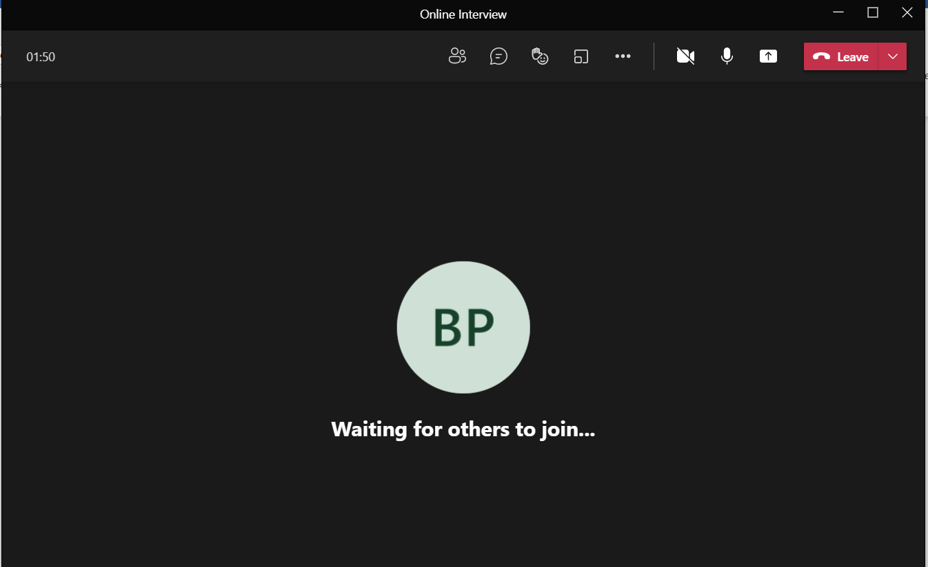
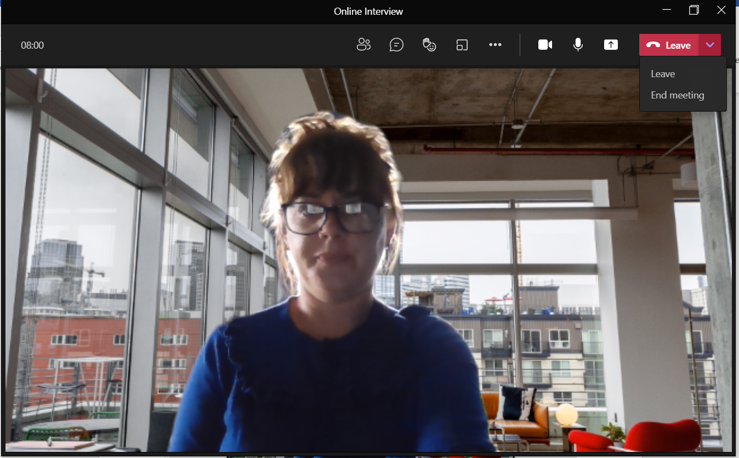



Slide 7
Troubleshooting
You may be asked to give permission for your browser to access the microphone and camera for the virtual interview. Please ensure that you agree to this.
Try closing the app and re-joining the virtual interview by clicking on the link again.
Please test your devices prior to interview including headphones.
If you are using a mobile, please ensure that you position your phone correctly.
Please ensure that your background is free from themes or distractions.
You will need appropriate lighting to ensure maximum visibility throughout your interview see interview guidance document.
Please ensure your chosen device is fully charged as this may affect your microphone and camera capabilities.
Should you experience any technical difficulties connecting to your interview or during your interview, you should notify the Interview Board directly by contacting them at your allocated interview time via telephone by dialling +353 1 592 0938 and enter your conference ID number below (beneath the Join Microsoft Teams link). The Board will then notify a member of the Recruitment Section who will then contact you. Please note, interviews will not be conducted via telephone.

Slide 8
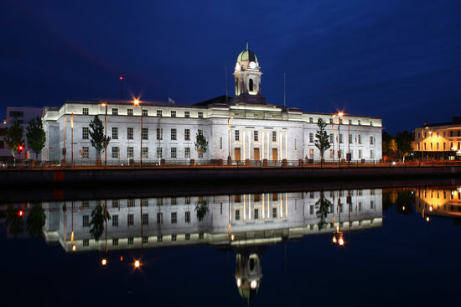



Thank you for applying to work with us in Cork City Council.
Please direct any queries you may have in relation to the competition to a member of the Recruitment Team by emailing recruitment@corkcity.ie
www.corkcity.ie

