Slide 1
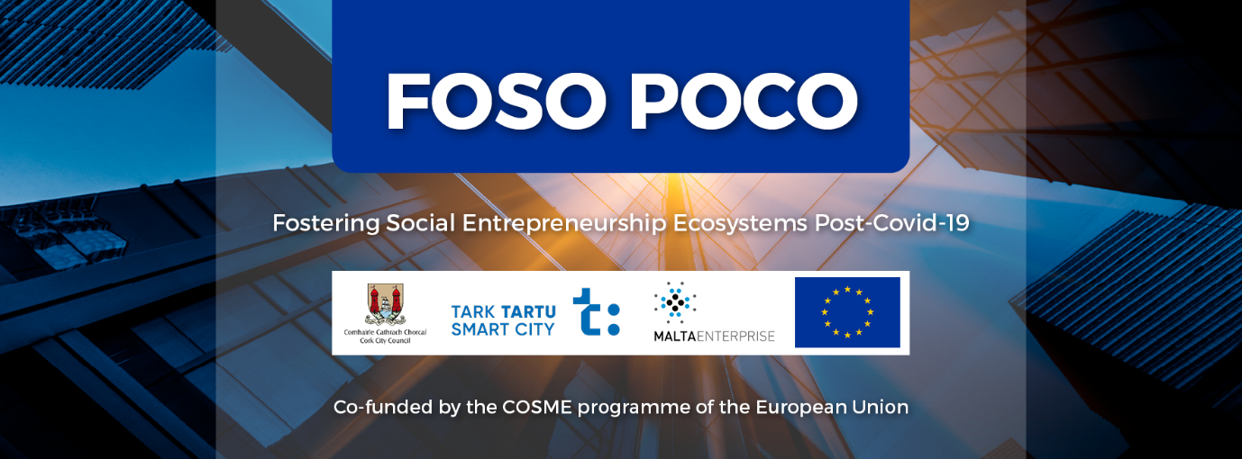
Fostering Social Entrepreneurship Ecosystems Post-Covid 19
21 July 2021

Slide 2
Agenda
9.00a.m. Welcome by Workshop Chairman: Mr. Chris Gordon, CEO of the Irish Social Enterprise Network
9:05a.m Introduction: Donal Guerin, FOSO-POCO Project Manager, Cork City Council .
9:15 a.m. Local ecosystem for social enterprises in Ireland and Cork: Presentation by Donal Guerin, Project Manager, FOSO-POCO, Cork City Council
9:30 a.m. Local good practice 1: Presentation by Margaret Healy, Re-think Ireland who support innovative social enterprises working in communities across Ireland
9:40 a.m. local good practice 2: Presentation by Ms. Cathy Buchanan, Manager, Meitheal Mara, community boat yard in Cork and training centre
9:50 a.m. Q/A and peer review of Ireland and Cork’s ecosystem for social enterprises (open discussion)
10:20 a.m. Break 10’
Thematic workshop: Establishing local supports to assist social enterprises in a post-Covid economy to further their viability and job creation prospects
10:30 a.m. Thematic workshop expert: Presentation by Mikel Irujo Amezaga, Minister for Economic and Business Development in the Regional Government of Navarre in Spain and Rapporteur European Committee of the Regions
10:50 a.m. Thematic workshop, practitioner: presentation by Mr. Steven Flint, Manager, Cork Deaf Enterprises
11:10 a.m. Thematic workshop local expert: presentation by Mr JJ O’Connell, Manager Northside for Business, Cork
11:30 a.m. Break 10’
11: 40 a.m. Panel discussion – thematic discussion 20’
12:00 p.m. Breakout Rooms /Discussion/Networking on Thematic Topic – 20’
12:30 p.m. Closing remarks 15’
12:45 p.m. End

Slide 3
Please write one sentence that describes how you feel that Covid-19 has affected social enterprises?
Similar to other enterprises it has affected them badly although government supports have been good
it has been significantly harder to for social enterprises to get up and running for those that arn't based online
Move to online activities
made them more relevant
It may have presented challenges or opportunities...
Social enterprises need to tackle a higher level of vulnerability in society
In Malta the format of a Social Enterprise still does not exist legally - however those enterprise that have this objective yet are registered in a different form were as badly hit as any other business
online environment opportunities
As far as we know, COVID-19 has certainly decreased the social enterprises' income dramatically.
Lack of operational funding
The Covid-crisis had significant negative impact on social enterprises
It has been difficult financially but has created new opportunities as well as digital health and especially mental health innovations are gaining a momentum
Covid-19 put all enterprises to find solutions to survive - stressful times where all had to be creative.
It has put more focus on social entrepreneurship and its importance.
has made us more creative and resilient
Many social enterprises were critical in their communities during Covid-19
Made them more resilient, rooted to their mission

Slide 4
Please write one sentence that describes how you feel that Covid-19 has affected social enterprises? (continued)
...
It has made the situation more challenging.
The pandemic has hit Social Enterprises in the same way it has hit other business entities
Although the pandemic has undoubtedly affected all businesses, in Malta, the lack of legal recognition may have hindered social enterprises from attaining financial assistance that would best be suited to assist it as they may not have fit accurately in the assistance being offered to businesses or voluntary organisations separately.
Lockdown, no visitors
Increased awareness of the value and impact of the social economy
The social enterprises have had difficulties with financial survival
This area has been heavily impacted due to a number of reasons.
challenge
Impact on commercial activity has seen both negative and positive aspects.
Many social enterprises have experienced a significant decrease in traded income
Finance- sustainability
Increased demand for services
Some enterprises managed to develop faster, some had to take time off, but the new market situation has affected the mental health of many social entrepreneurs.
It has presented great practical challenges but has created a whole new world of opportunity. The value of social enterprise is being witnessed throughout society.

Slide 5
Social media Links
Webpage created: https://www.corkcity.ie/en/doing-business-in-cork/european-projects/foso-poco
Facebook https://fb.me/e/1detAGFkK

Slide 6
Questions for breakout rooms
How has Covid-19 affected social enterprises where you are based?
Have sufficient local supports been provided to social enterprises where you are based?
What additional help do you think is needed?

