Slide 1
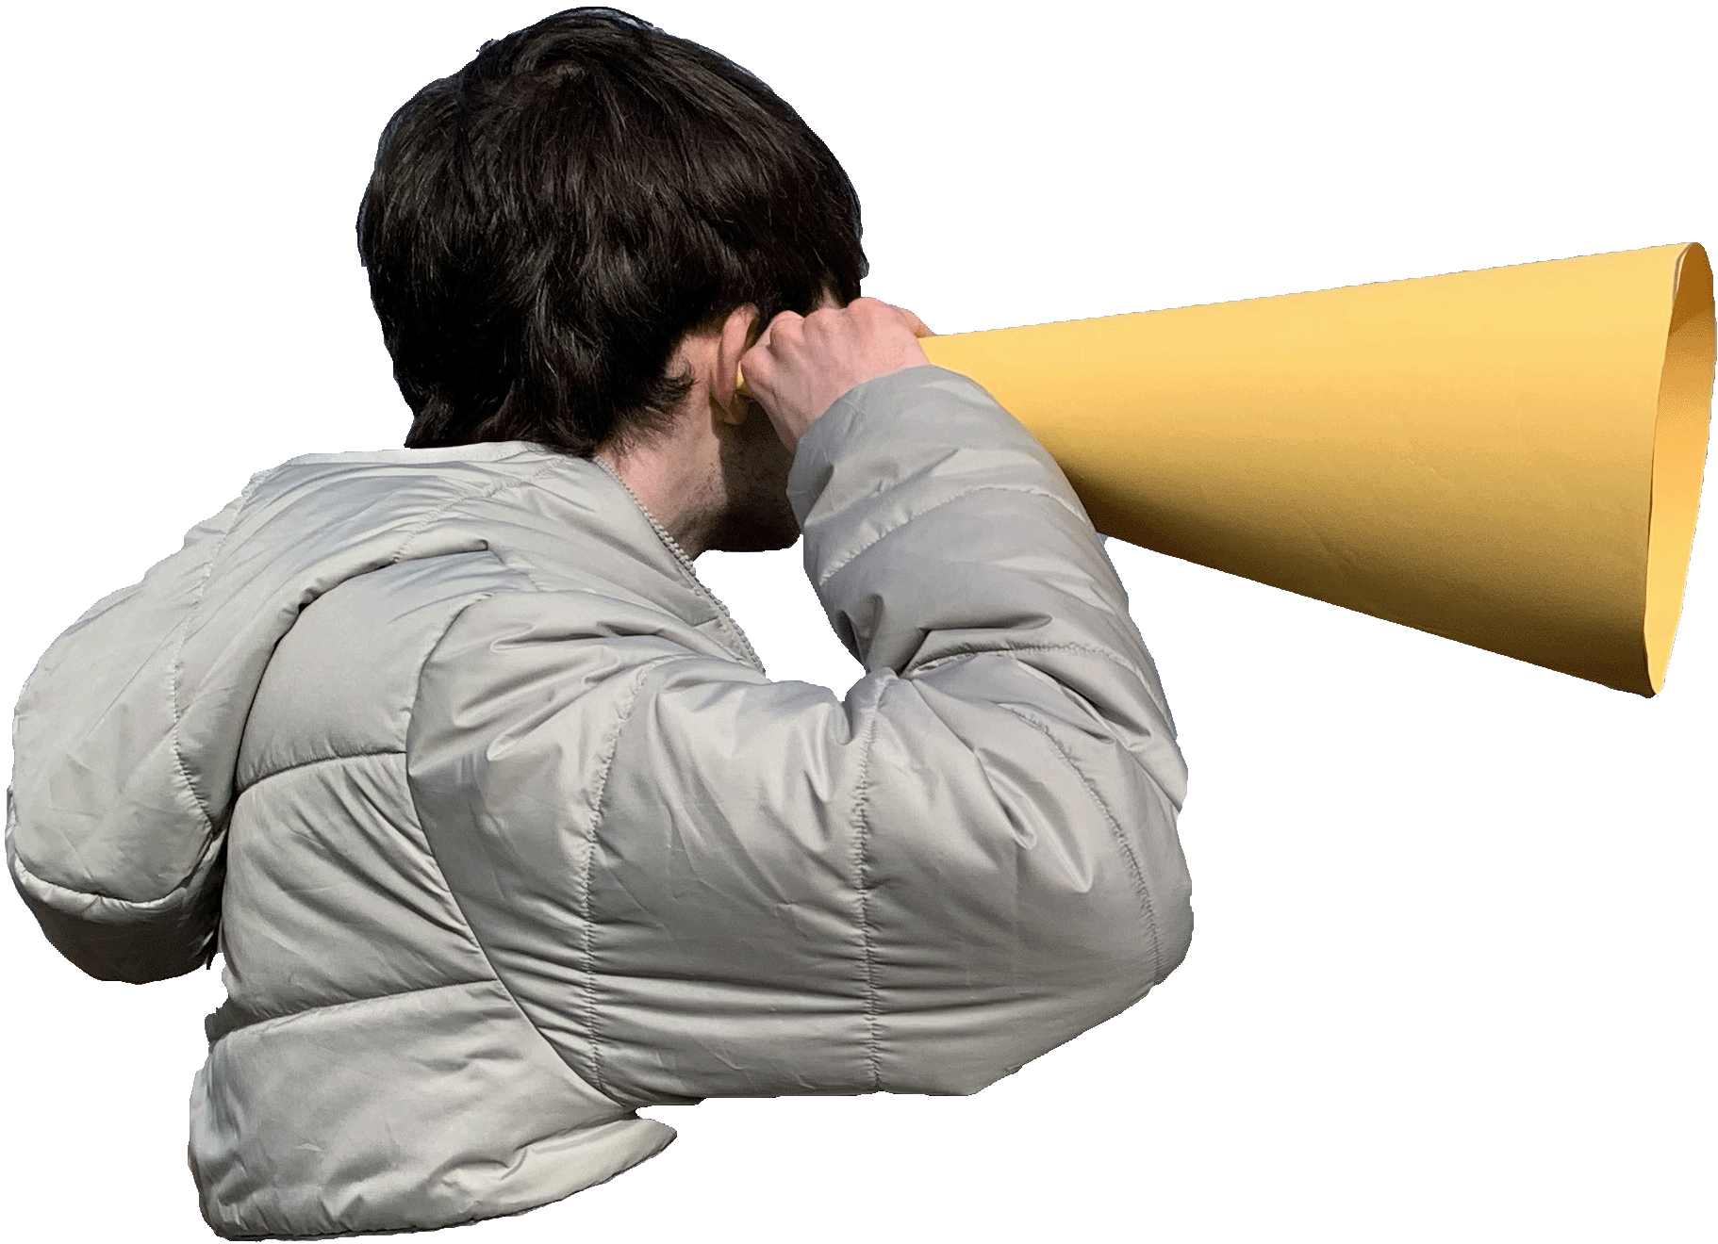
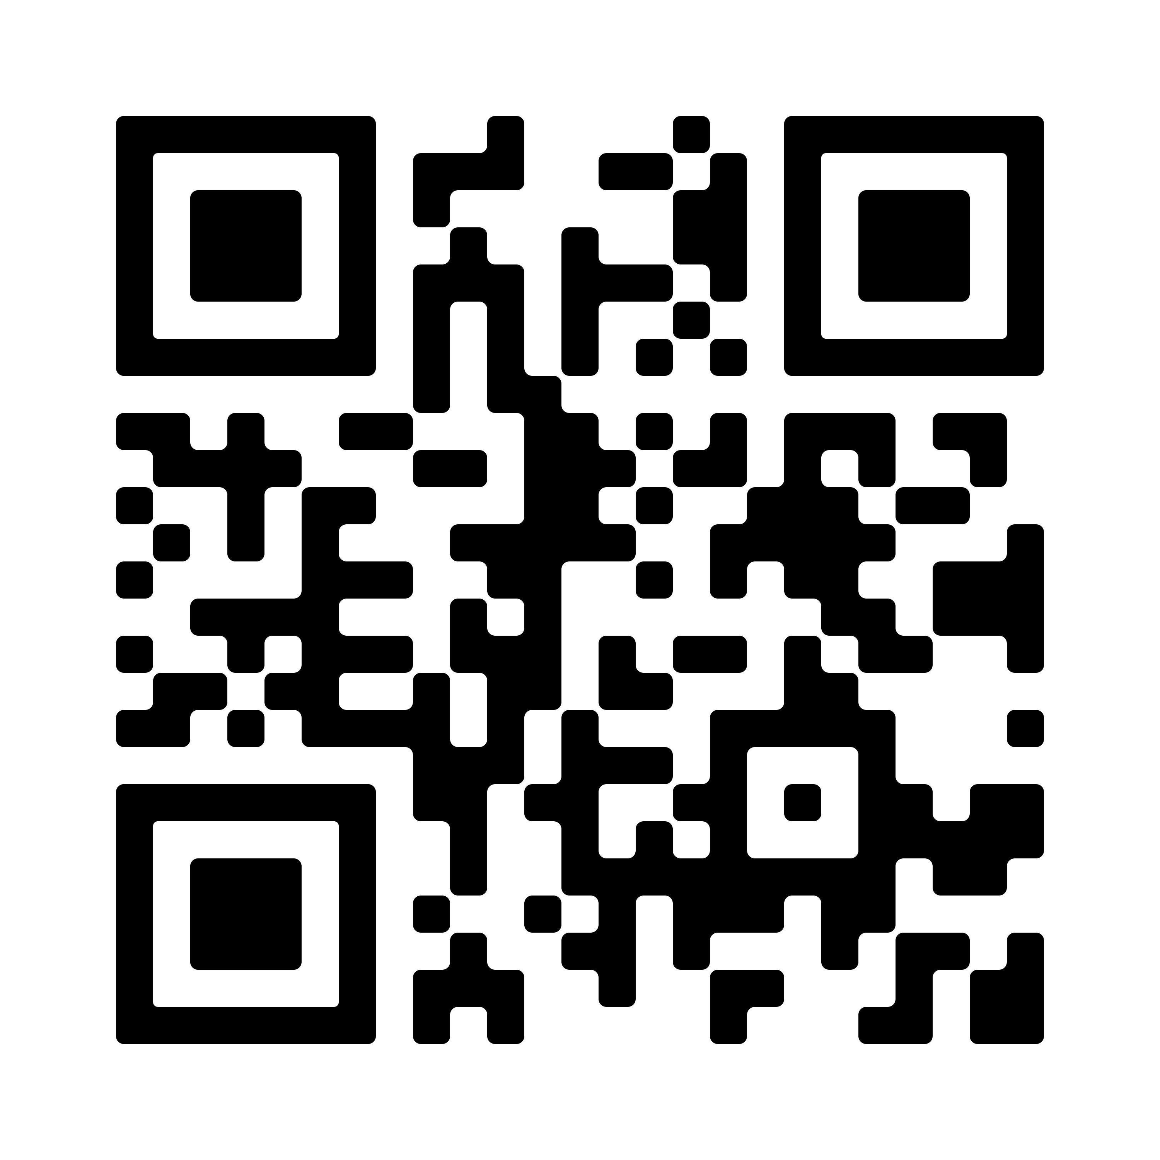
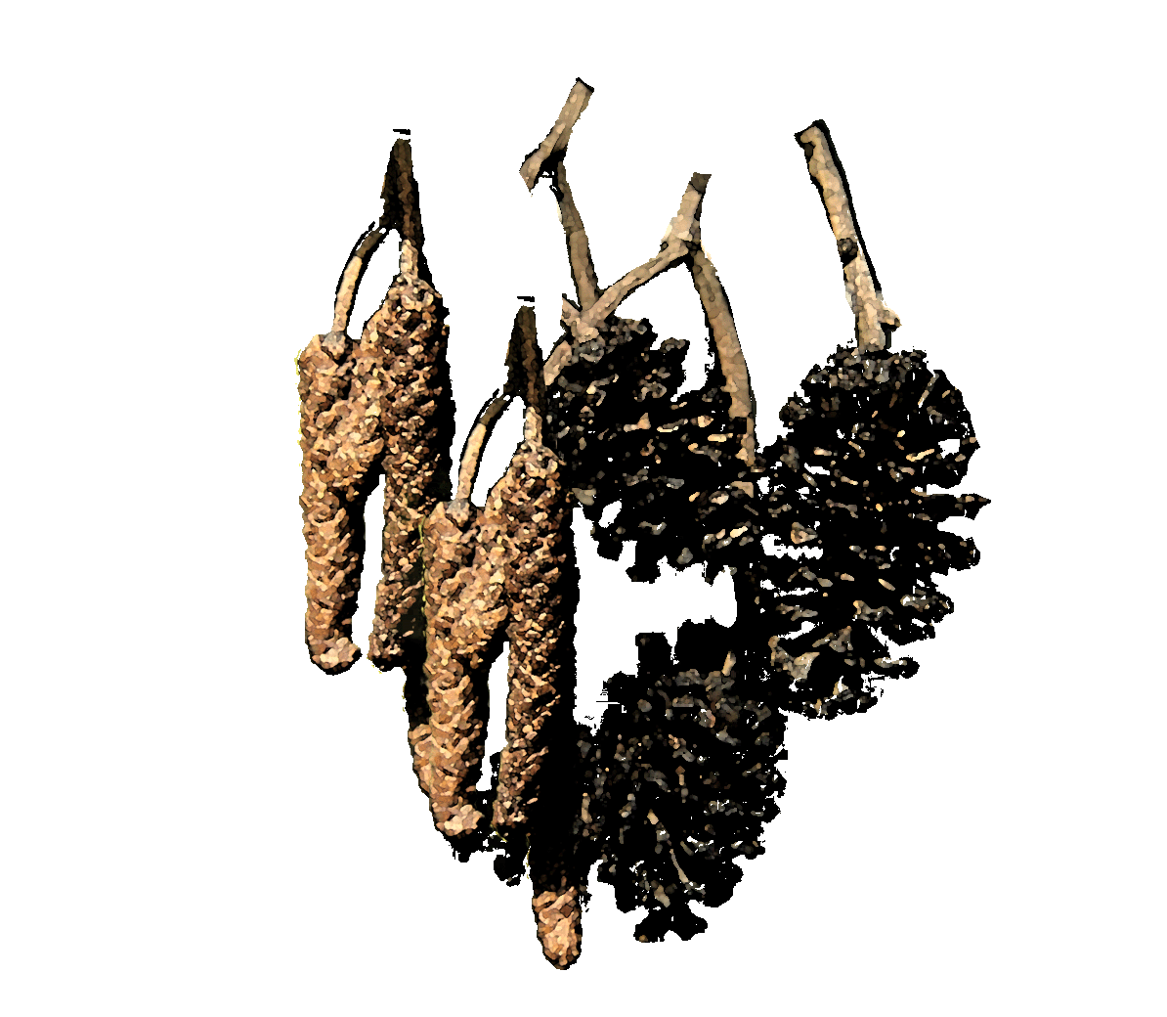
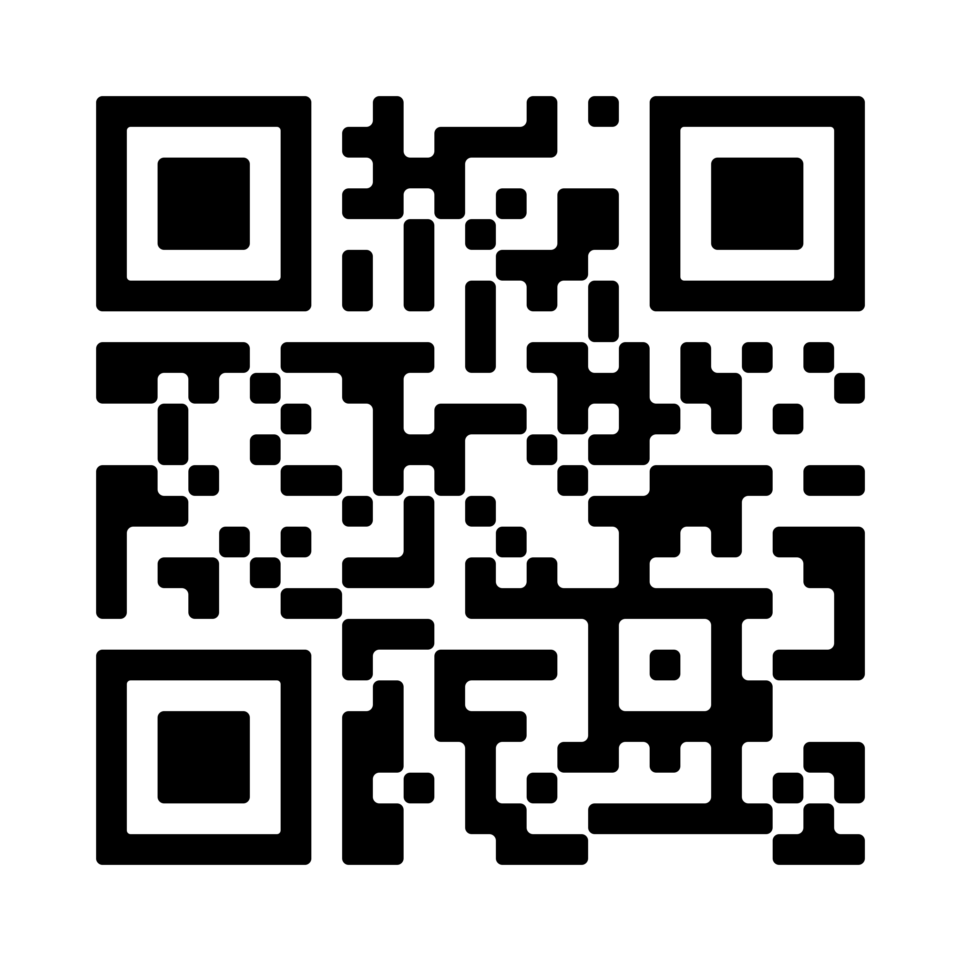
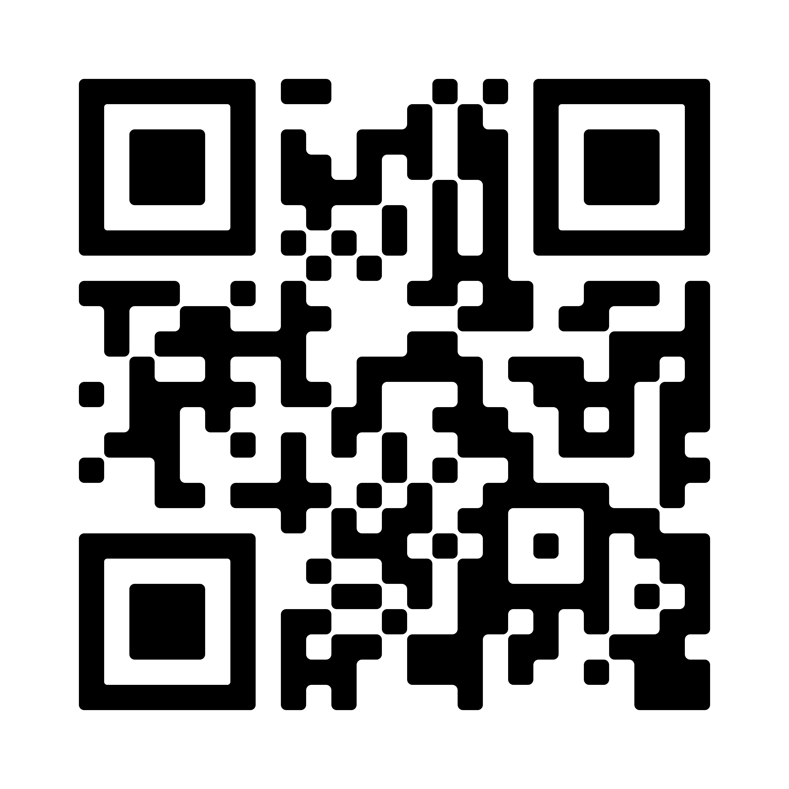
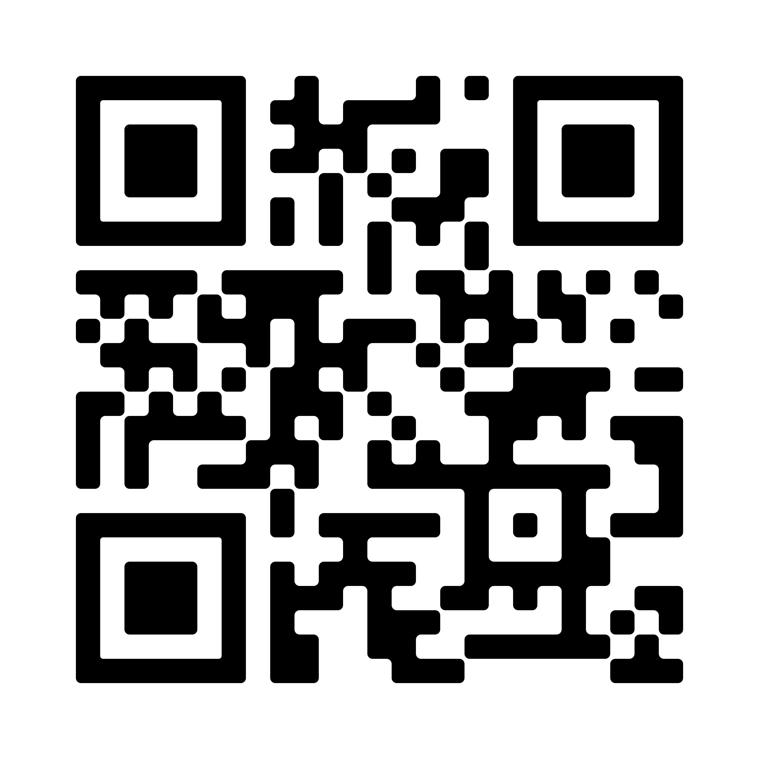
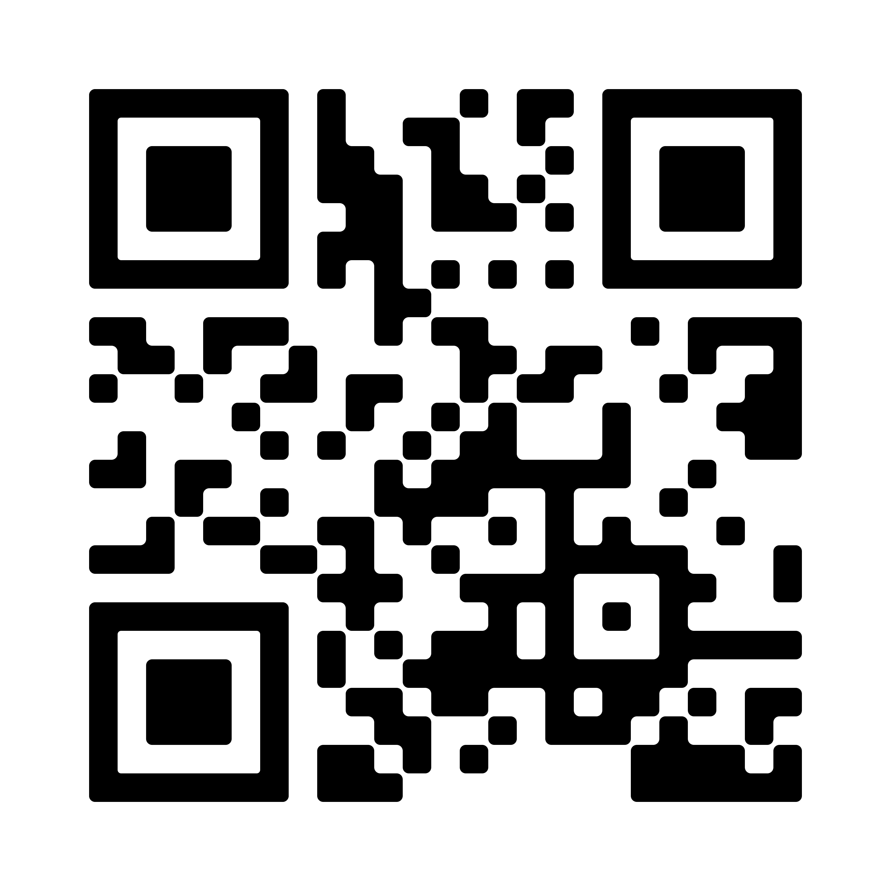
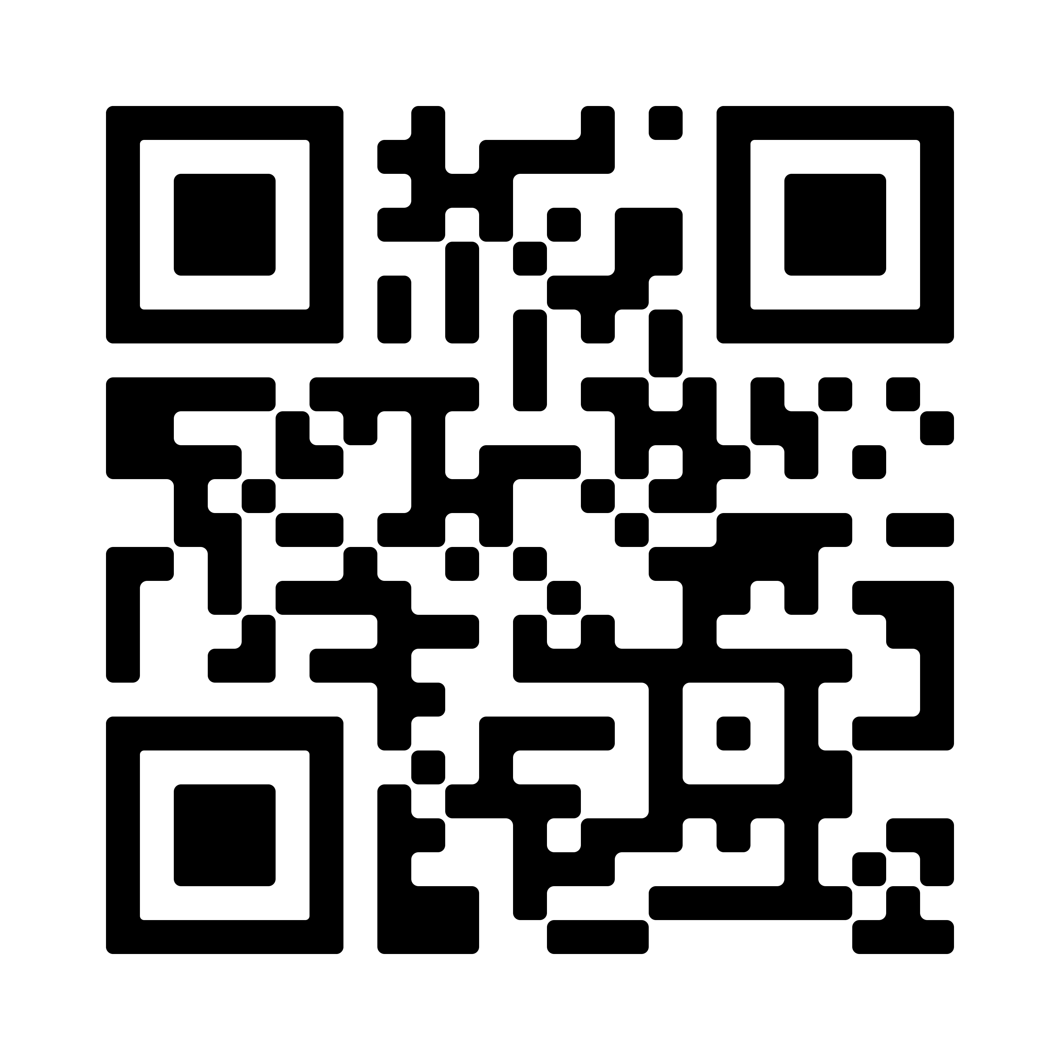
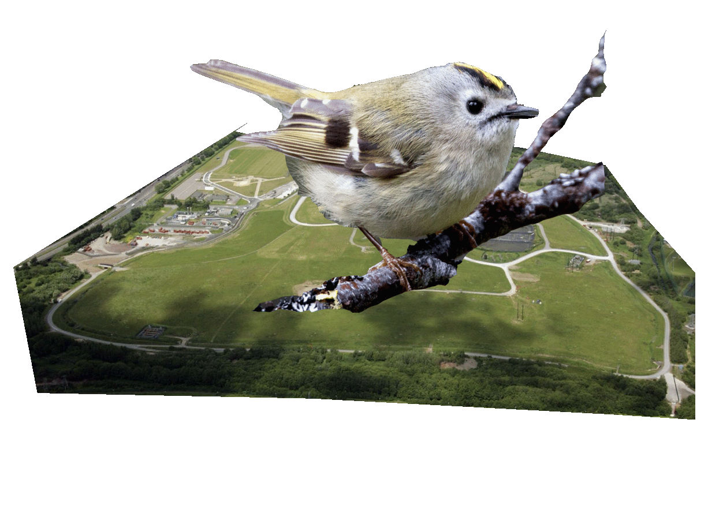
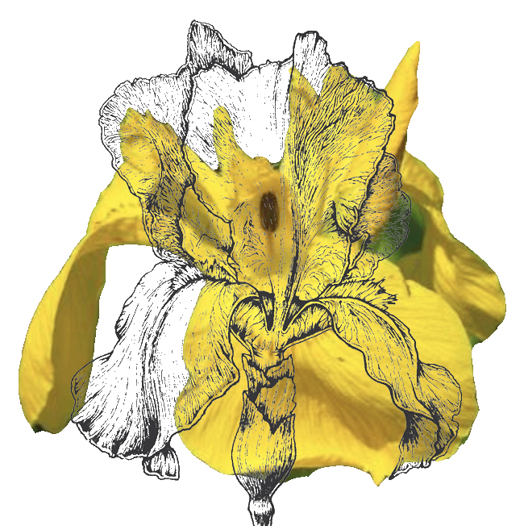
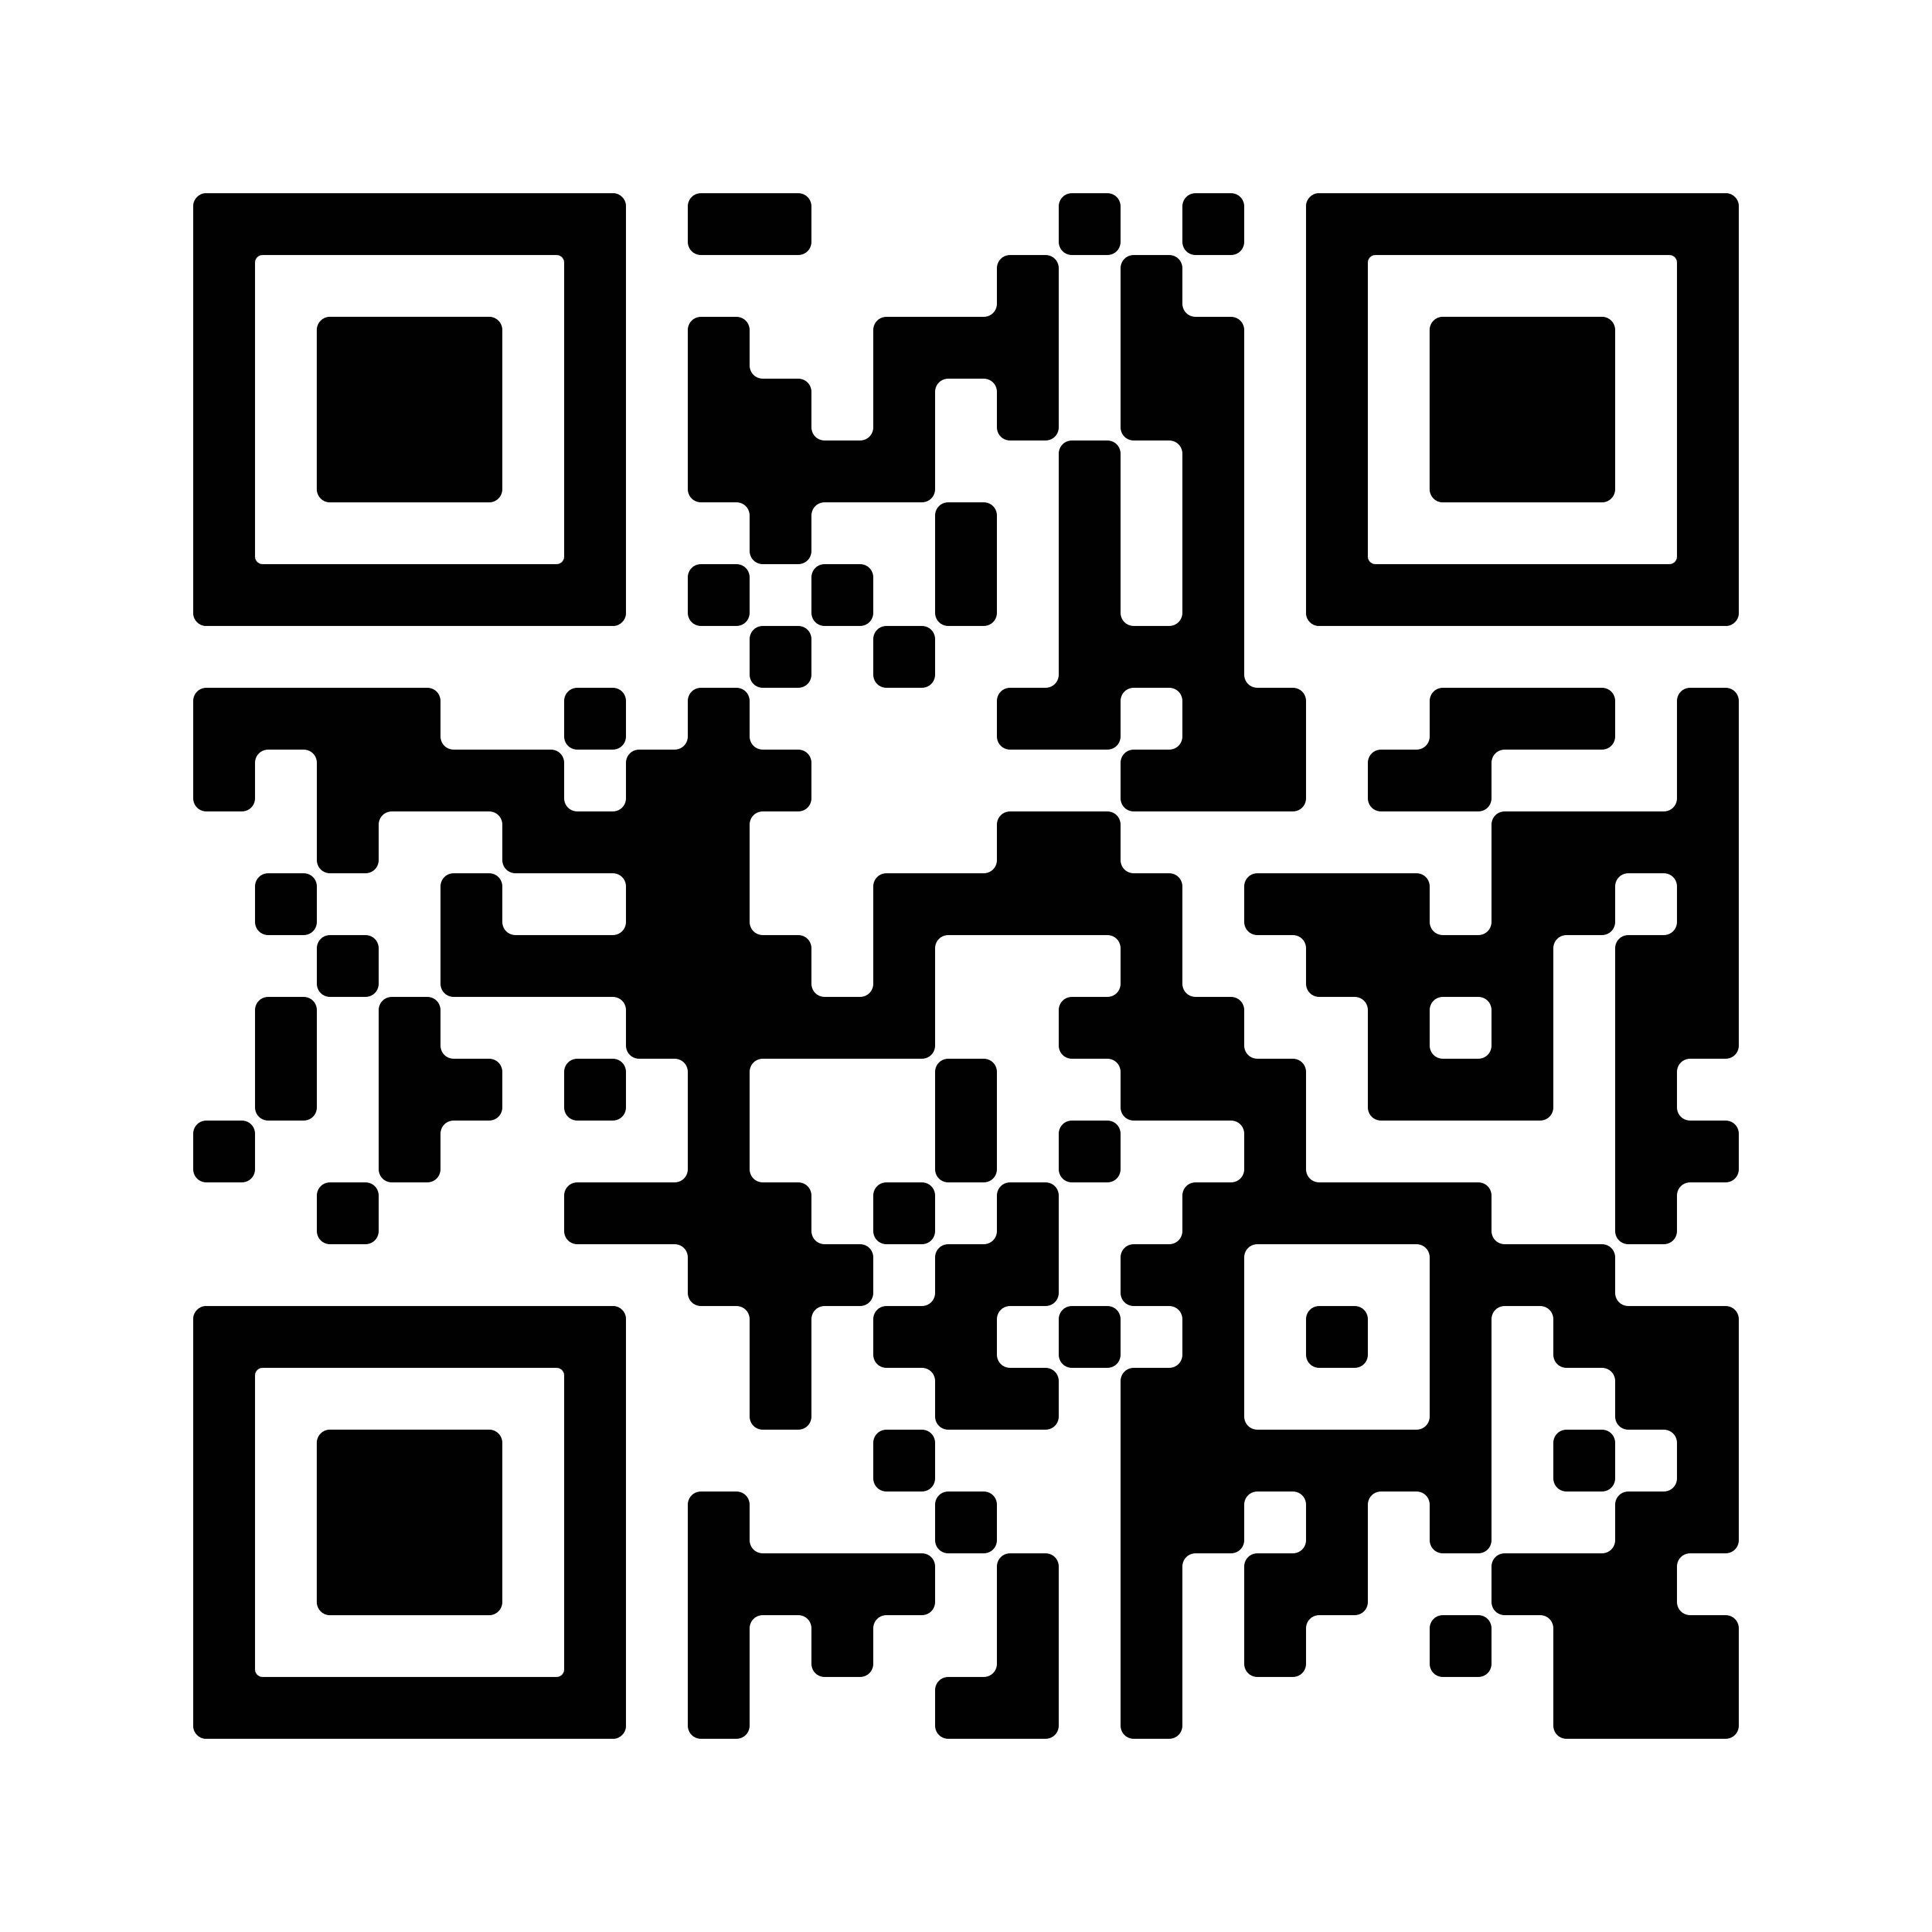
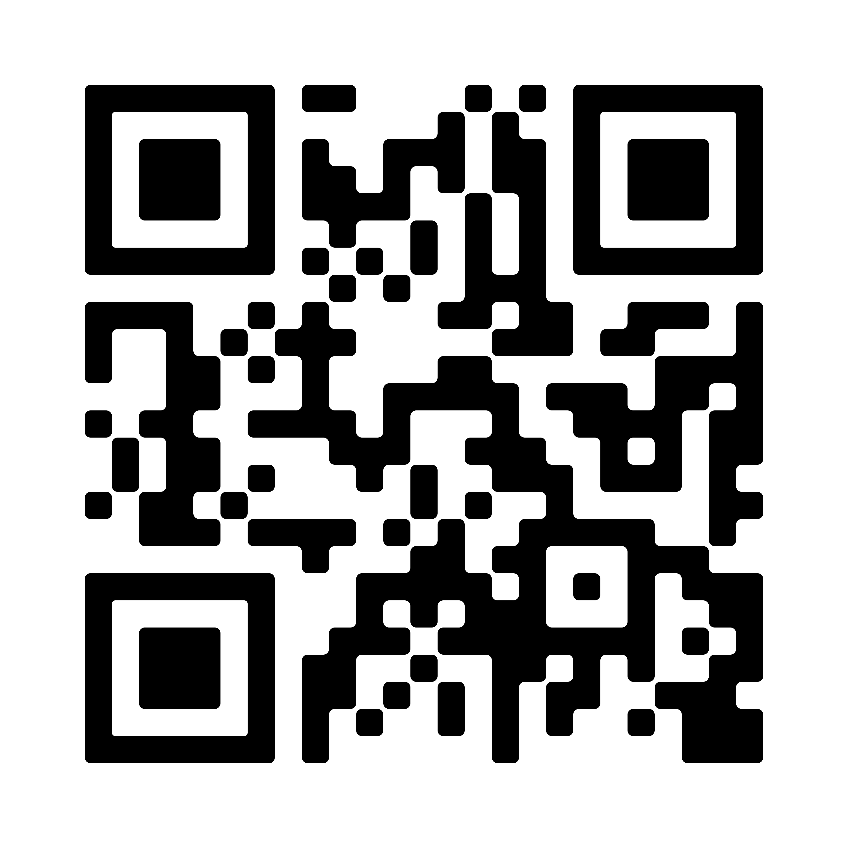
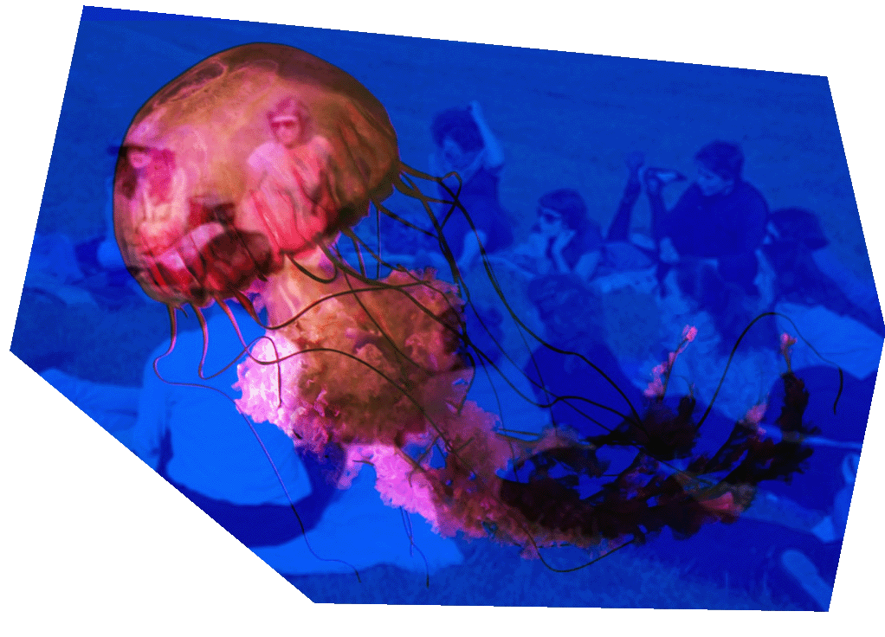
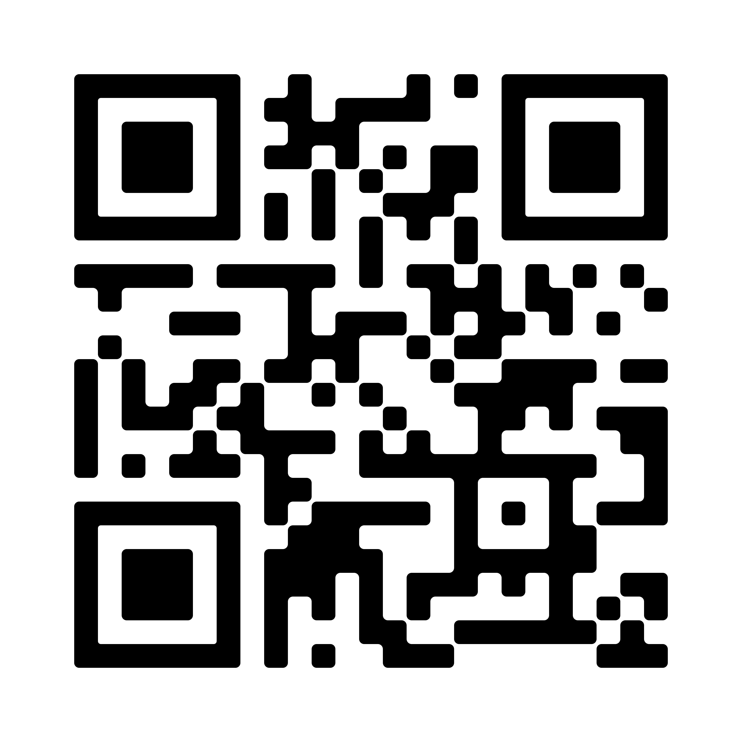
11.30am 1.00pm | SATURDAY 21 MAY Walk with Us The Story from Landfill to ParkLife Find out about the history of the parks transformation from landfill to public greenspace. The first imaginings, fascinating engineering works and the care, maintenance and future plans for the park as a habitat for the wider community of life. Led by - Liam Casey, Roy Watson and Kevin Ryan
1.00pm - 2.30pm | Draw with Us Botanical artist Therese Cooper will lead a small group in a close encounter with the wild plants of Tramore Valley Park through the particular artistic skill of Botanical Drawing. Focusing on the park's wetland plants, participants will draw with Therese, as she introduces you to this artistic skill. Led by - Therese Cooper
2.00pm - 3.30pm | Walk with Us A walking tour of the wetlands of Tramore Valley Park. Wetlands are an area of land that is saturated with water either permanently or seasonally, and where the water table is near or at the surface. These wetlands are home to a large diversity of plant and animal species and form an important network of ecological sites for many species on migration. The walk will cover the importance of wetlands for biodiversity and how everyone can help in the managing Irish Biodiversity through citizen science platforms such as the National Biodiversity Data Centre and Citizen Science Stream Index. Bring suitable footwear for wet ground and a pair of binoculars, if you have them! Led by - Cork Nature Network’s - James O’Mahoney and Nicole Crawford
 | SUNDAY 22 MAY
11.30am - 1.00pm | Make Poetry with Us Kerri wrote to us, ‘It may seem at first an unappealing invitation— I mean, who wants to write a poem about rubbish’?! This published poet will lead us into a mindful writing practice on the site. Participants consider your own material pasts or the imagined material pasts beneath our feet. This process of writing a poem is fun and very accessible to all writers regardless of age or previous experience. This form of poetry itself is an accumulation, it can go on without end if you wish to continue with it as a practice beyond the time of the writing session. Led by - Kerri Sonnenberg
1.30pm- 1.50pm | Listen with Us A second chance to witness this Live Sound performance from the KinShip Artist in Placement Jesse Hallaway and plants of TVP. Jesse is collaborating with Tramore Valley Park’s plant life in the creation of two sonic pieces. The first is a live improvised performance with various plants connected to a computer program. The impulses received from the plants and the artist's improvisation will create a live soundscape in the park. The artwork show new ways of interacting with sound, new connections between organic life and digital hardware, and new sounds from outside the realm of human constructs. He says, “If there is an intelligent message within these systems, we’re listening”. By KinShip Artist in Placement - Jesse Hallaway & Plants of TVP
2.00pm- 3.00pm | Walk with Us Cllr. Kieran McCarthy will host a walking tour of Tramore Valley Park focusing on the landscapes, histories and memories of the locality. Kieran regularly leads heritage walks in and around Cork city. Since 1999, Kieran has written his well-known weekly column, Our City, Our Town, in the Cork Independent. He is also an occasional heritage columnist with the Irish Examiner. Led by - Cllr. Kieran McCarthy
3.30pm- 5.00pm | See with Us Alder Tree and Ink tour This workshop will involve a walk and talk about the Alder Tree; how to identify this graceful tree, its important role in the surrounding ecology, its significance in Celtic mythology, uses as a natural material and its historic role in natural dyeing. We will sample some Alder ink and make time for nature journaling and our own creative responses. You will leave with a recipe to make your own luscious Alder ink to be able to make your own experiments. Led by - Ashleigh Ellis …………………………………………………………………………………………………………………. The KinShip Project is a longterm public artwork, developing a variety of socially engaged cultural initiatives at Tramore Valley Park over 2022. Tramore Valley Park has been the site of great environmental change. From 1964 to 2009, this site was used as a landfill for Cork city. The remediated landfill site opened as a public park in 2019. The KinShip art project offers communities an opportunity to respond creatively and critically to the ecological and climate action challenges we face today. The overall aim of the art project is to develop a sense of connection between the people of Cork and the ecology of the park. This project is an opportunity to develop a new relationship with the park, modelling care as a civic responsibility to all the inhabitants. This is a space to alter our mindset about the relationship we have with the natural world, to address the legacy of ‘throw away’ culture and to engage with new modes of managing waste.
May 22nd is World Biodiversity Day
this year's theme is
“Building a shared future for all life”
To mark World Biodiversity Day
The KinShip project has programmed a weekend
of FREE citizen-led EVENTS
Tramore Valley Park
ALL WELCOME
See Eventbrite & QR codes here to Sign-Up
2.30pm - 4.30pm | Join Us Join the Composting Feminisms reading group with an open mind. Discuss texts that explore intersectional interests of feminisms and environmental humanities. Participants will be exposed to ideas outside of the echo chamber of social and news media, meeting other people for face-to-face exchange and a possibility of creating a more sustained platform As a former landfill site now recast as a recreational amenity Tramore Valley Park demands deeper excavations of our own understanding of the kinds of humanity our future requires and how we might mould ourselves for the times to come. Led by - Sheelagh Broderick and Claire Ahern
4.15pm- 4.35pm | Listen with Us Live Sound performance from the KinShip Artist in Placement Jesse Hallaway and plants of TVP.. Jesse is collaborating with Tramore Valley Park’s plant life in the creation of two sonic pieces. The first is a live improvised performance with various plants connected to a computer program. The impulses received from the plants and the artist's improvisation will create a live soundscape in the park. The artwork show new ways of interacting with sound, new connections between organic life and digital hardware, and new sounds from outside the realm of human constructs. He says, “If there is an intelligent message within these systems, we’re listening”. By KinShip Artist in Placement - Jesse Hallaway & Plants of TVP

